Slide 1
Statistical Valentine
Hamburger Fold Card
Advisor: Bob Hayden

Slide 2
Front page

Slide 3
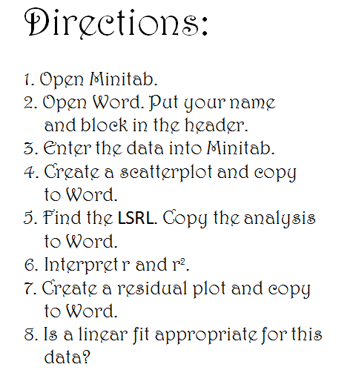
Inside Left

Slide 4
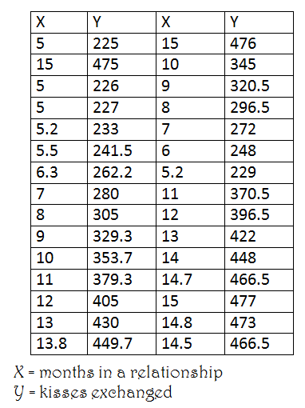
Inside right

Slide 5
Back page

Slide 6
What will they see?

Slide 7
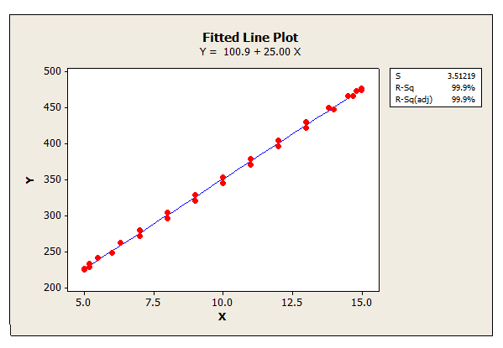
Scatterplot

Slide 8
Residual plot

Slide 9
How’d you do that?!

Slide 10
First create the residual plot, 50 wide but only -1 to +1 high.
Add those “residuals” to a deterministic equation like:
y = 100 + 25x + resid.
This scrunches up the residuals and obscures pattern.
Calculator: x-values L1
y-value (residuals) L2
100 + 25L1 + L2 L3
Then regress L3 on L1.

Slide 11
Inference booklet
A True Origami Challenge
(makes frogs look easy)

Slide 12
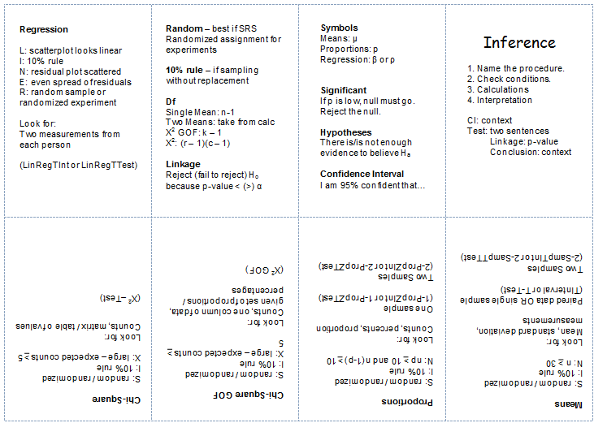
unfolded

Slide 13
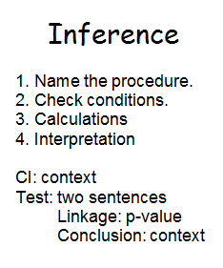
Book cover

