Slide 1
Podcasting Potentials for Statistics
Brandon Hanson
Presented at the 2012 AP Statistics Best Practices Night

Slide 2
Why Podcasting?
?

Slide 3
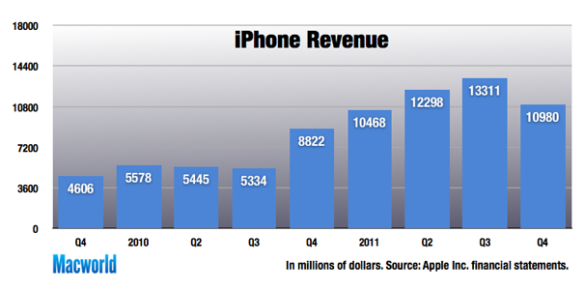
People are buying iPhones

Slide 4
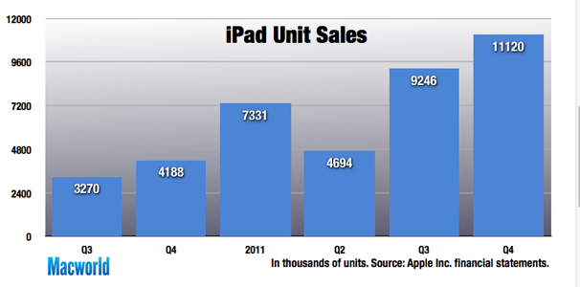
And iPads

Slide 5
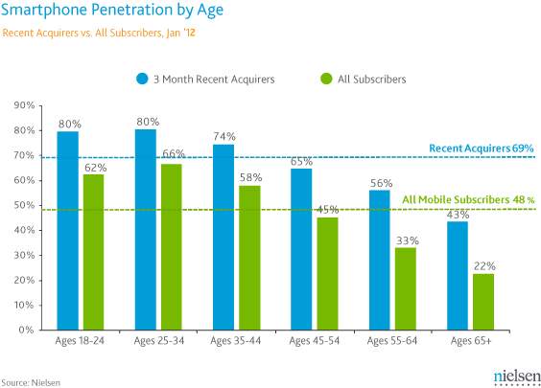
Students have smartphones

Slide 6
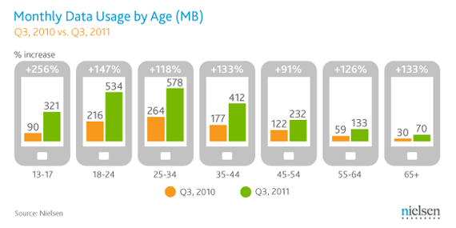
And they are using them

Slide 7
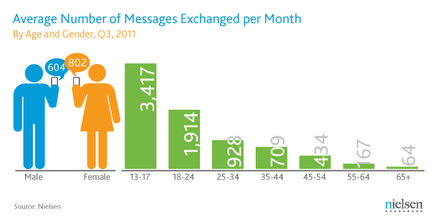
They are communicating differently

Slide 8
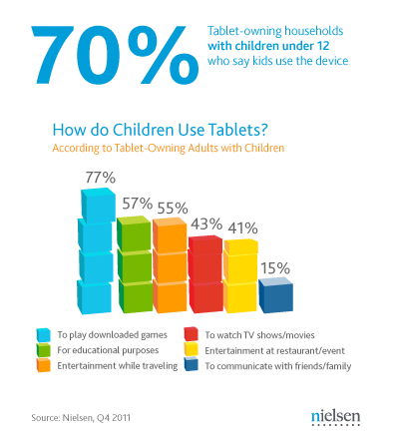
Tomorrow’s students are learning with tablets

Slide 9
My Experience
Over 50 podcasts created since 2010.
Most are created for review and remediation.
Taught one chapter using nothing but podcasting.
Student responses are mostly positive
Convenient
Helped them review for tests
Some responses have been negative
Didn’t need the podcasts
Connection speeds were too slow to watch

Slide 10
Podcasting: Hardware
Audio Podcast
Built-in or external microphone
Computer
Video Podcast
Video recording device such as webcam or FlipCam
Tripod

Slide 11
Podcasting: Software
Audio Podcast
Audacity (Free)
Lame MP3 Encoder

Slide 12
Podcasting Software
Video Podcast
Desktop Capturing: CamStudio (FREE), Camtasia
Video editing: Windows Movie Maker (FREE), Adobe Premiere Elements, or Cyberlink Video Director
File Converter: AnyVideo Converter (FREE)
Most paid video editing software will include this ability

Slide 13
Podcasting: Recording
Writing a script is often suggested
I prefer to just wing it
Quiet room is preferred
Minimize interruptions
Shorter is better

Slide 14
Scan Now!

Slide 15
Podcasting: Tutorials and Examples

Slide 16
Podcasting: Subscribing
If podcast is submitted to iTunes, it is searchable.
http://itunes.apple.com/us/podcast/mathematically-hanson-stat/id443412441
You can place buttons on your website
http://www.rhs.rcs.k12.tn.us/teachers/hansonb/podcasttraining/ictcm/ictcm.htm
If you have an iPad or iPod, you may need an addition free app
Current Favorite: RSSRadio

Slide 17
Podcasting: Alternatives
Upload videos to YouTube
Upload videos to social networking site such as FaceBook.com or MyBigCampus.com

Slide 18
Podcasting: Points to Remember
Remember: Push not Pull
Podcasting is different from watching online videos.
Subscription
Students are learning from YOU.

