Slide 1
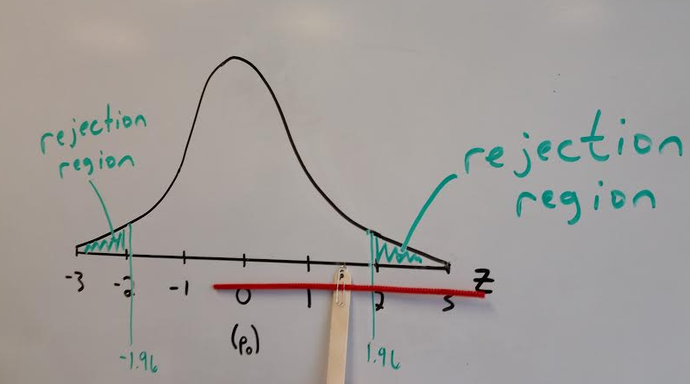
The Relationship between Confidence Intervals & Hypothesis Tests
DUALITY STICKS
John Krickl
Glenbrook North High School
Northbrook, IL
jkrickl@glenbrook225.org

Slide 2
Motivation

Slide 3
How can we make this STATEMENT more meaningful to students?
“Using the same sample, a two-tailed hypothesis test with significance level α will generally* make the same decision about a hypothesized value of a parameter as will a 100(1 - α)% confidence interval.”
*The difference between does not make
this relationship perfect, but I do not believe this detracts from the big picture of the activity. Also, this difference makes for a great discussion in class. (See slide 16 for more reflection on this)

Slide 4
Construction
Popsicle stick
Paper clip
Pipe cleaners
Red pipe cleaner: cut to (just over) 29 cm
Green pipe cleaner: cut to (just under) 25 cm

Slide 5
RESULT

Slide 6
Logistics
For the sake of simplicity and multiple uses, this activity is constructed visualizing a 95% confidence interval for a population proportion in conjunction with the rejection region of a two-tailed, one proportion z-test with alpha = .05.

Slide 7
LOGISTICS
One standard deviation will be represented by 7.5 cm when drawn on the board. Thus:
Red pipe cleaner (29.4 cm) represents a 95% confidence interval
Green pipe cleaner (24.7 cm) represents a 90% confidence interval
Having this consistent scale allows you to quickly recreate a sketch of the standard normal distribution that will match up with the sticks we have created

Slide 8
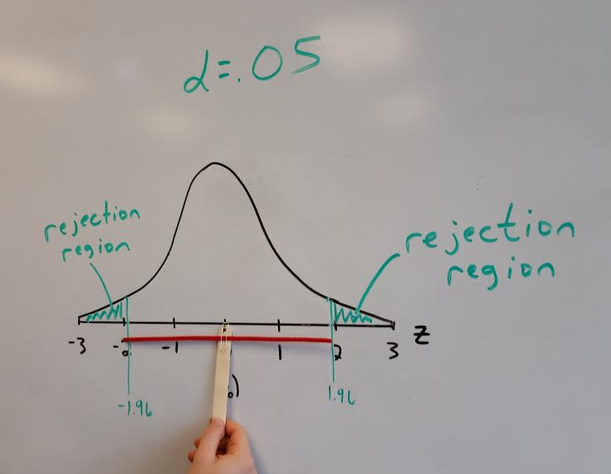
I start by having the students put the popsicle stick at the center of the distribution.
While this is a sketch of the standard normal distribution, I put p₀ in parentheses
below z = 0 to remind students than an obtained p-hat equal to p₀ corresponds with a
test statistic of 0.

Slide 9
Both our CI and our hypothesis test do not find evidence against p0.

Slide 10
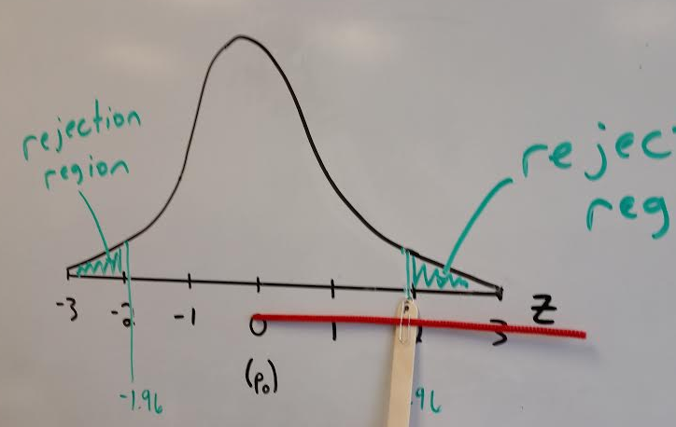
The A-HA moment for many students. Students notice that when our
obtained p-hat (or corresponding test statistic) is on the cusp of the rejection
region, our 95% CI just barely captures p₀. The instant we move further right…

Slide 11
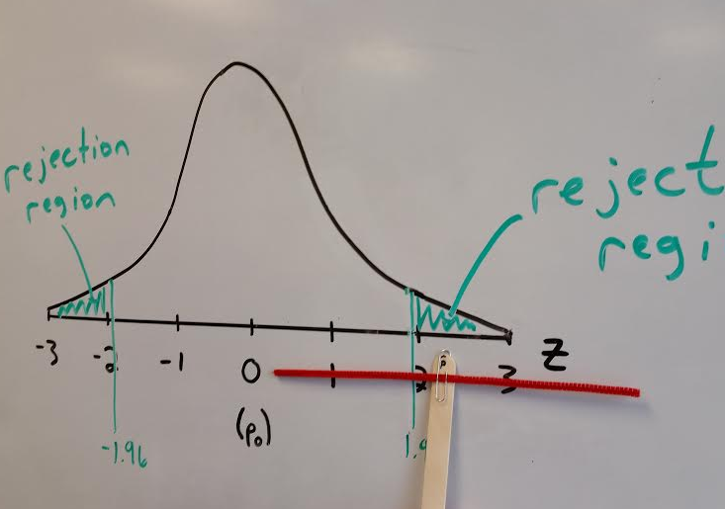

Slide 12
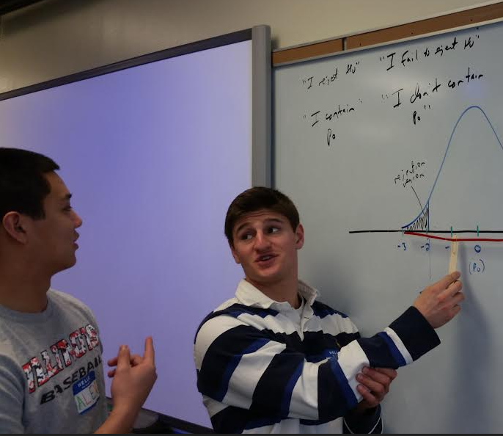
In action
Students work in pairs.
Person A focuses on the result of
the hypothesis test.
I reject H₀ (p = p₀).
I fail to reject H₀.
Person B focuses on the result of the confidence interval.
“I do not contain p₀, so I reject p₀ as a plausible value for p”
“I contain p₀, so I do not reject p₀ as a plausible value for p”

Slide 13
BEFORE AND AFTER
Typical student answer in the past for why this duality occurs:
“Since the hypothesis test rejected p=.48, the confidence interval also rejects .48.”
After this activity:
“If we rejected H₀ , we had a test statistic larger than 1.96 or smaller than -1.96. Since the 95% confidence interval spans 1.96 standard deviations in either direction from our obtained result, we will be too far from p₀ to capture it in the interval.”

Slide 14
What about a one-tailed test?
For a one-tailed hypothesis test with alpha = .05, the test will (generally) make the same decision about a hypothesized value of the parameter that a 90% confidence interval will make.
While it is not too difficult to note that the rejection region of a one-tailed, one proportion z-test will either be z < -1.645 or z > 1.645, and 1.645 is the critical value for a 90% CI for a population proportion, I think it packs a lot more punch for the students to understand this relationship in a more hands-on way…

Slide 15
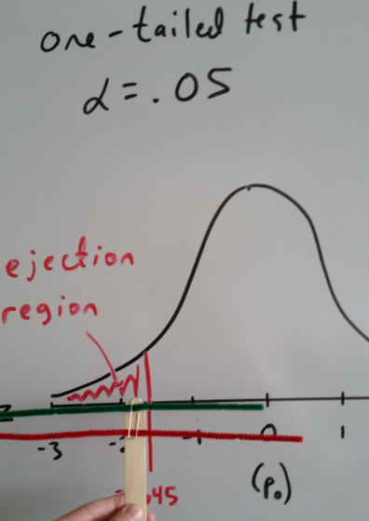
Students can see that the 90% CI backs up the decision of the hypothesis
test, but the 95% CI does not, as it still captures p₀.

Slide 16
CLOSING COMMENTS
The statement on slide 3 includes the word “generally” because in a one proportion z-test, we use p₀ when calculating the standard deviation of the sampling distribution of p hat. When we construct the confidence interval, we estimate p₀ with p hat, and therefore the standard deviation assuming H₀ is true & the standard error used in the confidence interval will not perfectly match. While this distinction is worth mentioning, I don’t believe it detracts from the message of the activity.
As mentioned previously, this made for a great discussion in class.
The same activity could be done in the context of inference for a population mean, but then degrees of freedom are involved (unless we know σ, which is unlikely). This is an activity that I use often & spontaneously in class, so I didn’t want to make a new scale/rejection region each time we had a new sample.

Slide 17
Thank you!
Please feel free to contact me with any questions or suggestions for improvement…
jkrickl@glenbrook225.org

