Slide 1
Speed Dating
Stacy Elliott
Durham School of the Arts
Durham, NC

Slide 2
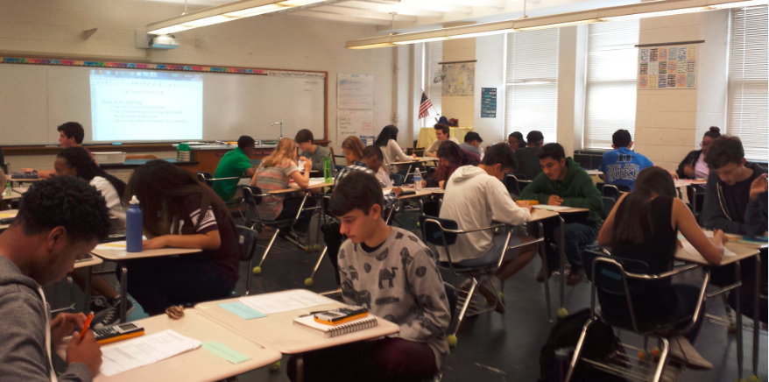

Slide 3
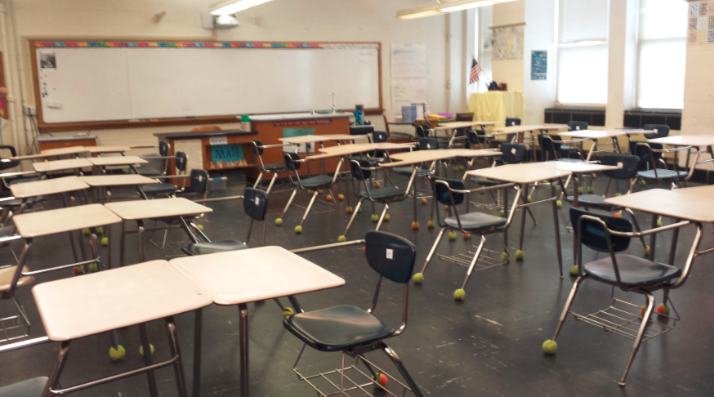
Arrange desks in pairs with space between for easy movement around the room.

Slide 4
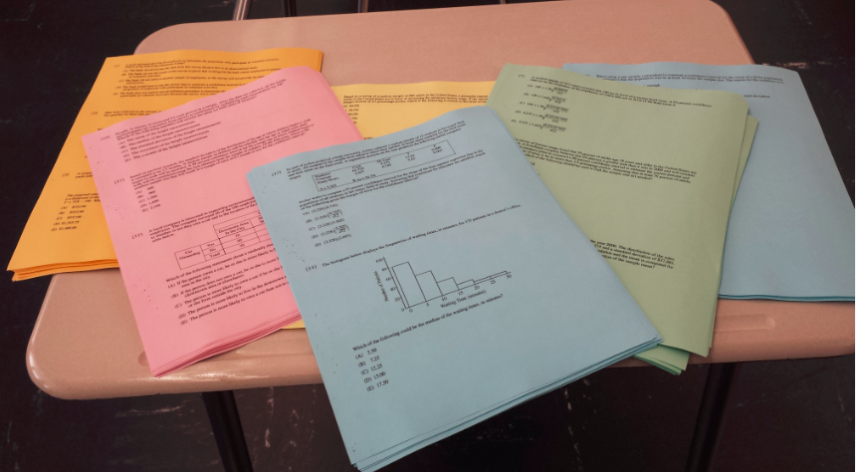
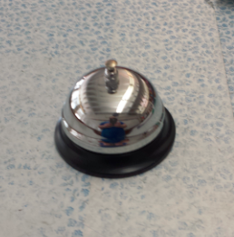
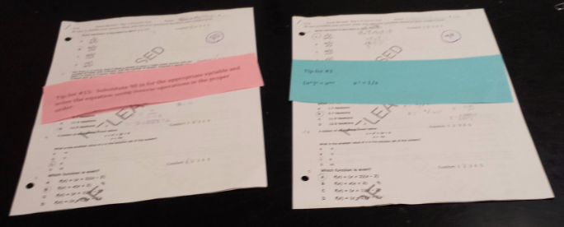
You will need:
* A set of question (multiple choice works best)
* A noise making device

Slide 5
Each pair of students is assigned a different problem and work together to become EXPERTS on that problem.
Each pair of students check with the teacher to make sure they have the right answer and ask any clarifying questions.

Slide 6
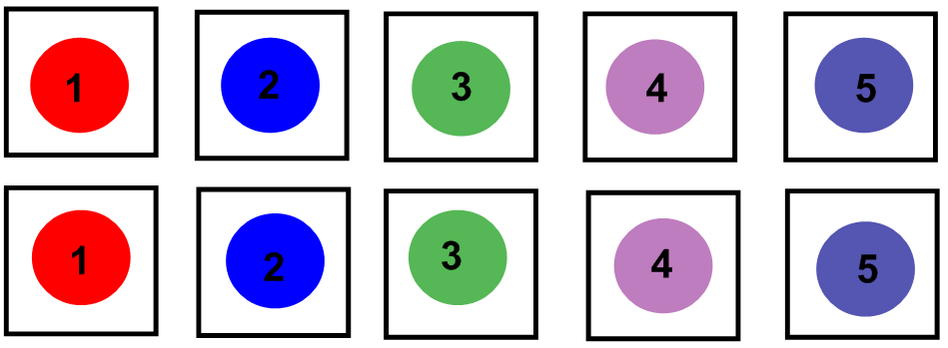
THIS SIDE DOES NOT MOVE

Slide 7
THIS SIDE DOES NOT MOVE
THIS SIDE MOVES ONE SEAT TO THE RIGHT

Slide 8
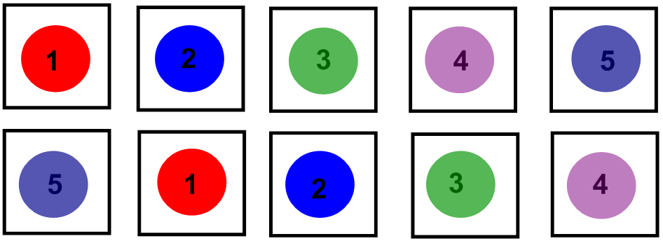

Slide 9
Each new pair of students exchange questions. Each person works on a new problem independently.

Slide 10
Each new pair of students exchange questions. Each person works on a new problem independently.
When a student has a question or answer, they check with the EXPERT sitting across from them (not the teacher).

Slide 11
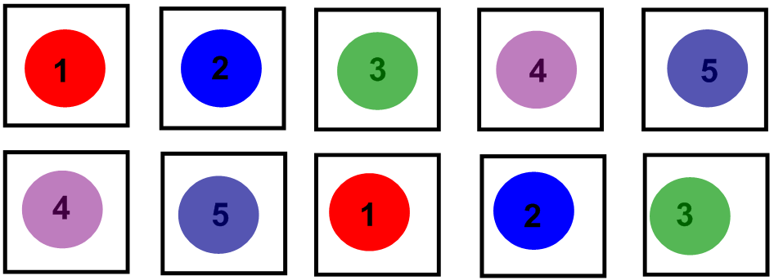
After a sufficient amount of time, you ring the bell signaling it is time to move.
Students move one more seat to the right and repeat the process again.

Slide 12
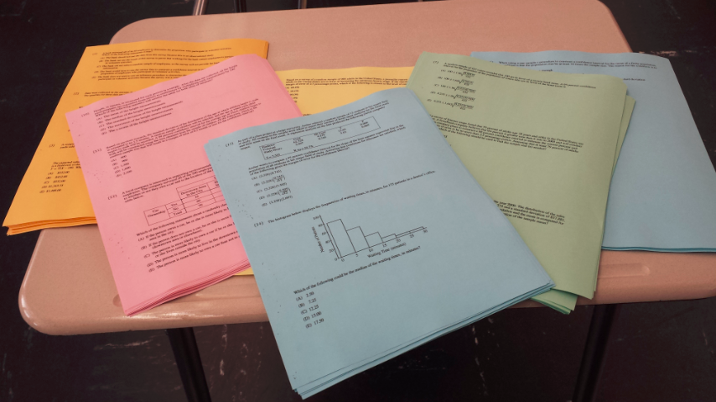
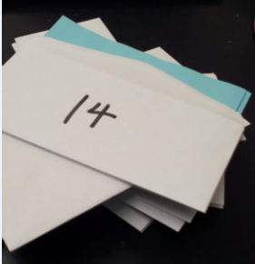
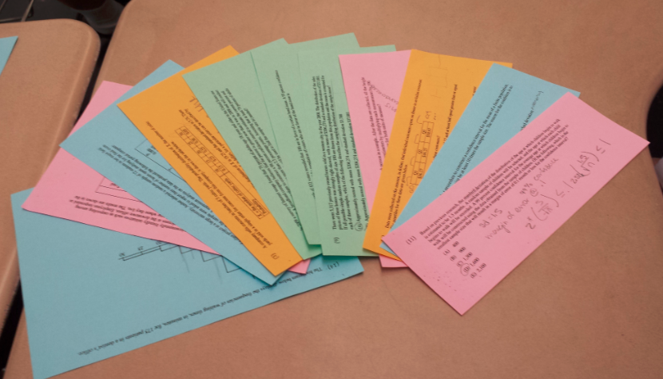
THE ENVELOPE METHOD

Slide 13
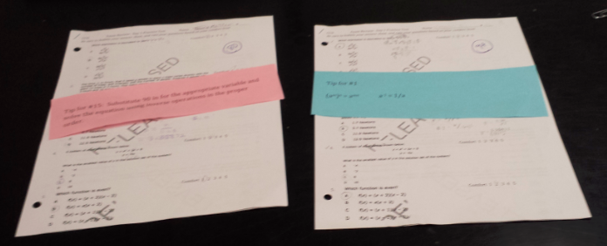
THE TIP SHEET METHOD

Slide 14
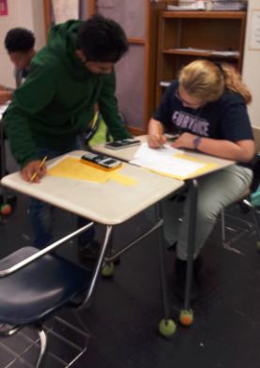
SET UP
Let N = Number of Students in the Class
You will need:
$\left\lceil \frac{N}{2}\right\rceil$ = Number of Questions
and
N = number of copies of each question

Slide 15
EXAMPLE
If you have 24 students, you will need 12 questions.
Envelope Method:
Make 24 copies of each question.
Put 12 copies of the each question in an envelope.
You should have 24 envelopes each with 12 copies of a single question.
Each person in an expert pair will have an envelope with 12 copies of their assigned question.

Slide 16
If you have 24 students, you will need 12 questions.
The TIP SHEET Method:
Compile all 12 questions into one document.
Make 24 copies of the document.
Make a tip sheet for each question.
Make two copies of each tip sheet.

Slide 17
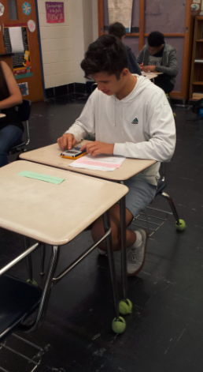
ODD MAN OUT

