Slide 1
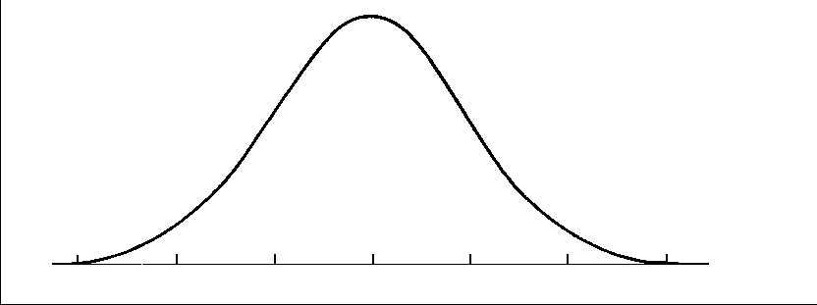
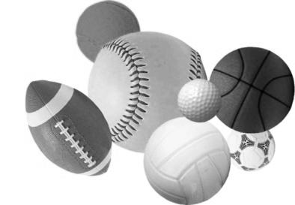
The Moneyball Effect: Teaching AP Statistics through Sports
Paul Buckley
Gonzaga College High School
Washington, DC
pbuckley@gonzaga.org
Notes:
Who am I?
20th year of teaching coming up
AP Stats for past 12 years
AP Reader for past 6
Reg Stats – SRIS
Coach – softball, golf, baseball, tennis

Slide 2
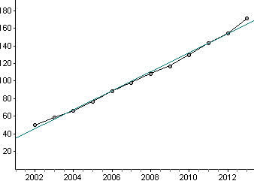
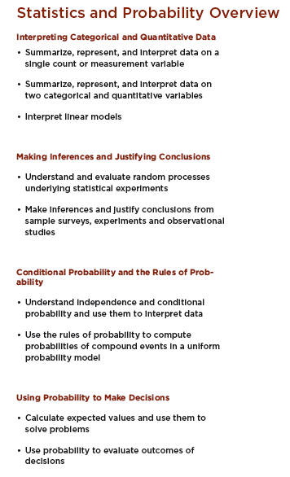
Why?
Growth of Statistics
Notes:
Why? Why AP Stats through sports?
Two premises – without which this talk is useless
first, growth of Stats
Rise of AP Stats exam – this year over 170,000 – over 1 million questions answered

Slide 3
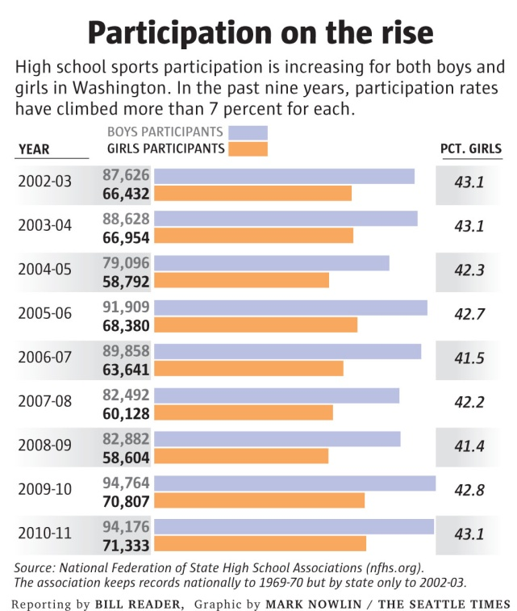
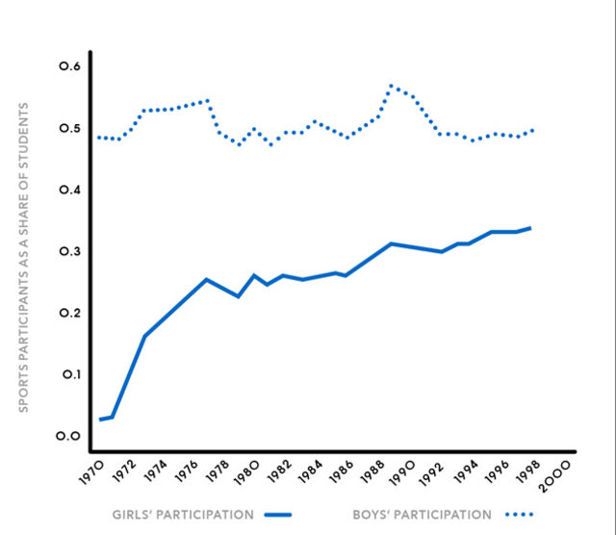
Why use Sports?
Notes:
2nd – growth of sports
Over 55% of all hs students play a sport.
How many activities are there that over half of your student body/your class takes part in?
You can tailor the activity to the area, the school, the team.

Slide 4
So how can Sports help us learn AP Statistics?
Notes:
So Stats is growing and more kids are taking it, and it can expected that that will continue to rise
Sports is also incredibly popular across gender - either in a participatory or observer standpoint
So here are three ways to use Sports to help the kids get Stats concepts – by providing a context they can understand, relate to, and remember

Slide 5
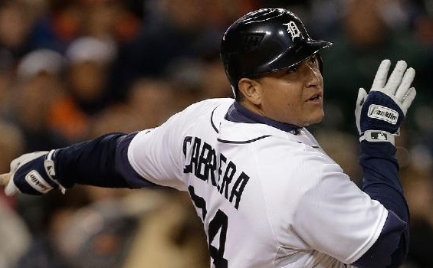
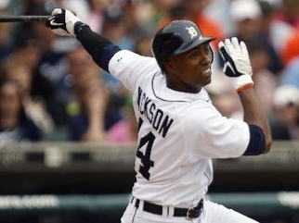
Statistical Inference Through Sports
Miguel Cabrera vs Austin Jackson Who is really responsible for Detroit’s success?
Notes:
When: As opening to unit on Statistical Inference
Pick any two sports entities to compare – two teams, two players – could be pro, college, own school, players from your own class!
Only an observational study, not an experiment, so even if we have statistically significant evidence, we cannot say that one or the other is the cause of Detroit’s success.

Slide 6
Two-Proportion Z Test

Slide 7
The Data
Notes:
Can introduce terminology here if you choose – but more important to get them thinking about the comparison they are going to make – introduce them to the logic of Stat Inference
Can talk how this data is representative of all data – ask them what type of sample this is (cluster)
Not reasonable to use a normal approximation for the sampling distribution

Slide 8
Simulate the Games
StatKey
Fathom
Notes:
Although a normal approximation cannot be used, it is possible to simulate the distribution of ˆ ˆ
P=hatMC – p-hat AJ. Under the assumption that the null hypothesis is true, 10,000 values of ˆ ˆ
P=hatMC – p-hat AJwere simulated. The histogram below shows the results of the simulation

Slide 9
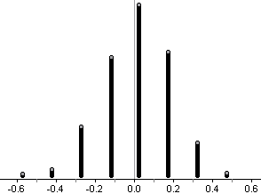
Simulation results
Likelihood = p-value
Notes:
Based on the results of the simulation, what can be concluded about the relationship between MC and AJ?
Spells out what a p-value is. Many, if not most, can make a conclusion from a hypothesis test, but can they interpret a p-value? Do they recognize what it represents? The questions are evolving – isn’t just a straightforward Inference question – they pervade the questions.

Slide 10
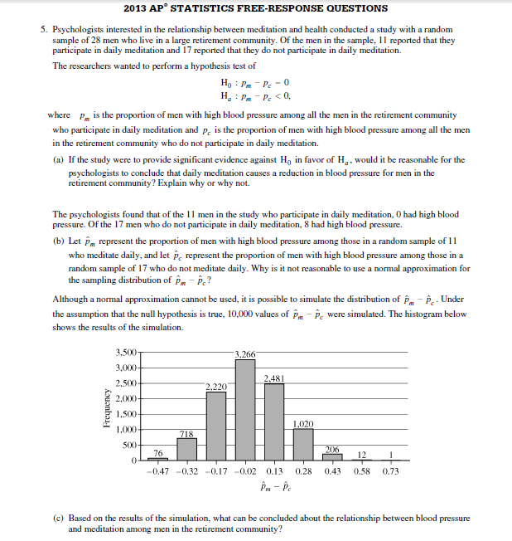
Notes:
This was this year’s #5
Importance of simulation – 3 of the last 5 years have had it –this year this question was the worst, and this part was the worst part of it
Teach them simulation – and doing it through sports is easy – it is easy for them to understand it.

Slide 11
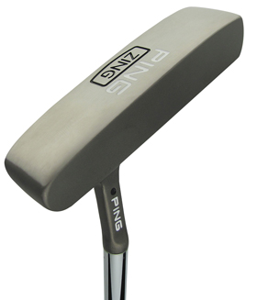
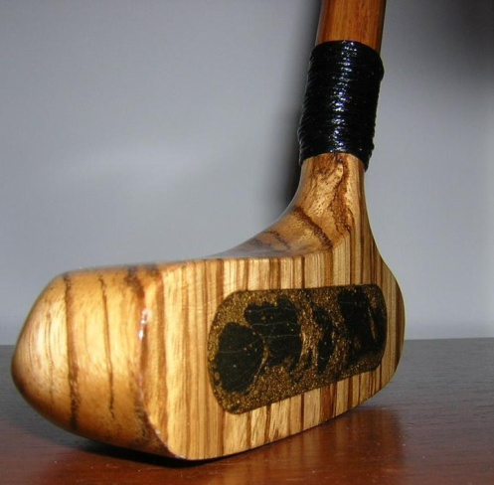
Experimental Design Through Sports
Which is the better putter?
Notes:
Regular stats class did basketball shooting – distraction vs no distraction
Control – ball, hoop, warmup, motion, conditions
Randomization – prevent ‘hot hand’
Easier to identify the response variable and what would affect it
Replication
Blocking?
Blinding?

Slide 12
The Experiment
Control – putter, ball, ‘course’, swing
Randomization – prevent ‘hot hand’
Easier to identify the response variable and what would affect it
Replication
Blinding
Blocking
Notes:
When: As opening to ED unit.
Run the experiment – Have them create or explore what would be needed for this experiment – to decide which is the better putter?
Do we need it to be one person putting, or a whole bunch of people putting? (Scope of Inference)
What elements do we need to control?
Do we need to randomize – don’t use that word yet – let them think of these issues in common sense terms. Make sure if they say no, that they tie it to the RV.
How many times do we need to putt with each putter? Just one? Why not? Enough – what does that mean?
Will they know which type of putter they are using? Is that important? (Might try harder with one or the other – so what)
Introduce obstacles – now what? (Blocking)

Slide 13
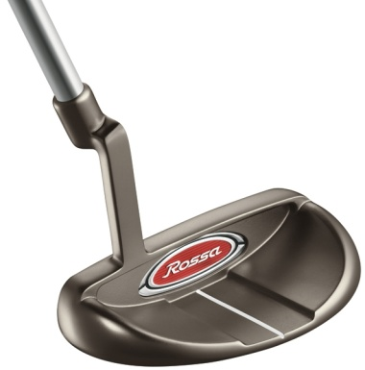
Experimental Design Through Sports
Which is the better putter?
Notes:
Use three putters – now it is a chi-square!

Slide 14
Regression Through Sports
Moneyball scene:
http://www.youtube.com/watch?v=yGf6LNWY9AI
Notes:
Discuss fantasy leagues
Role of GM – something anyone can do

Slide 15
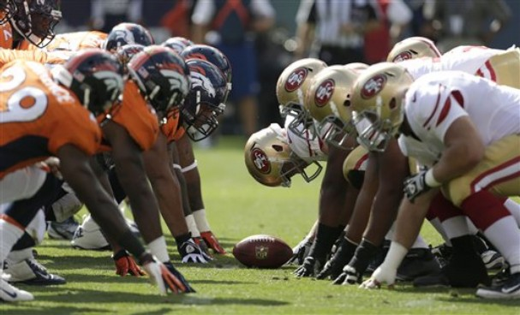
Regression Through Sports
Offense vs Defense Which is the better predictor of wins?

Slide 16
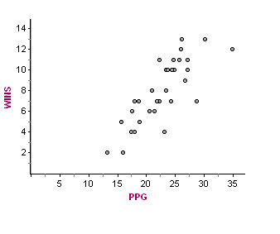
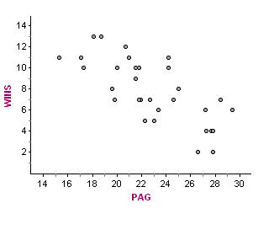
Notes:
Kids can probably see how points scored is better
Can lead to discussion of correlation and causation
Talk about s = st dev of residuals – can calculate in excel easily – typically, our prediction of number of wins is off by about …
Sports provides a context they can more easily grasp

Slide 17
Think of the possibilities…
Soccer: Free Kicks vs Goals
Hockey: Power Plays vs Goals
Golf, which is a better predictor of success, greens in regulation or number of putts?
Tennis: unforced errors or 1st serve percentage vs points won
Notes:
You can come up with regression examples for just about any sport.
The kids will be more engaged because it is something that interests them.
The material is ripe for this kind of discussion.
They can also then bring it back to their coach and possibly use it – imagine how cool that would be!
Also can segue way to multiple linear regression as a post AP topic

Slide 18
What else?
Putting together a relay team (track, swimming) – lesson in z-scores, normal distributions
Game strategies – situational hitting – conditional probabilities
Layups vs jumpers vs 3-pointers – non-linear regression
And ……?
Notes:
James Bush talk from BP

