Slide 1
The Rules of Engagement
Robin Levine-Wissing
Instructional Supervisor of Mathematics
Glenbrook North High School, Illinois

Slide 2
Formative Assessment
Assessment for learning, planning, re-teaching, reviewing, etc.
Group, partner, or individual work—takes place in many forms

Slide 3
Test Prep Reflection
Actively involves all students
Comparing scores of student samples
Scoring their own sample
#4 –students are writing about how they could bring their paper up to the top score
#5 –students write what a rubric “could be”
Students are never shown the real rubric
My students tell me this is the best activity to help them understand the expectations for writing a good paper on the AP exam.

Slide 4
Multiple Choice
Groups of 3
The number of questions given is the same as the number of groups you have
All groups do all questions
Randomly assign which question as group presents
Presentations are made based on why the incorrect choices are incorrect The correct answers are not discussed

Slide 5
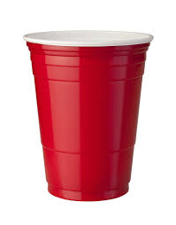
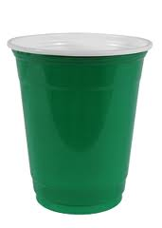
Managing Groups
Each group gets all three cups in a stack
Color showing is where group feels as they work through problems
Triage—where do you go to help

Slide 6
How Exit Slips Assist Collaborative Work
Use results for grouping the next meeting of your class---group two students still needing help with two students that completely understand---(from Dylan Wiliam)

