Slide 1
Z-Puzzles
Christine Wozniak
Cedar Creek High School

Slide 2
Puzzle can be adapted for many topics! This puzzle was originally adapted from an Algebra I puzzle.

Slide 4
Finished
Puzzle

Slide 5
That looks cool! How do I do it?

Slide 6
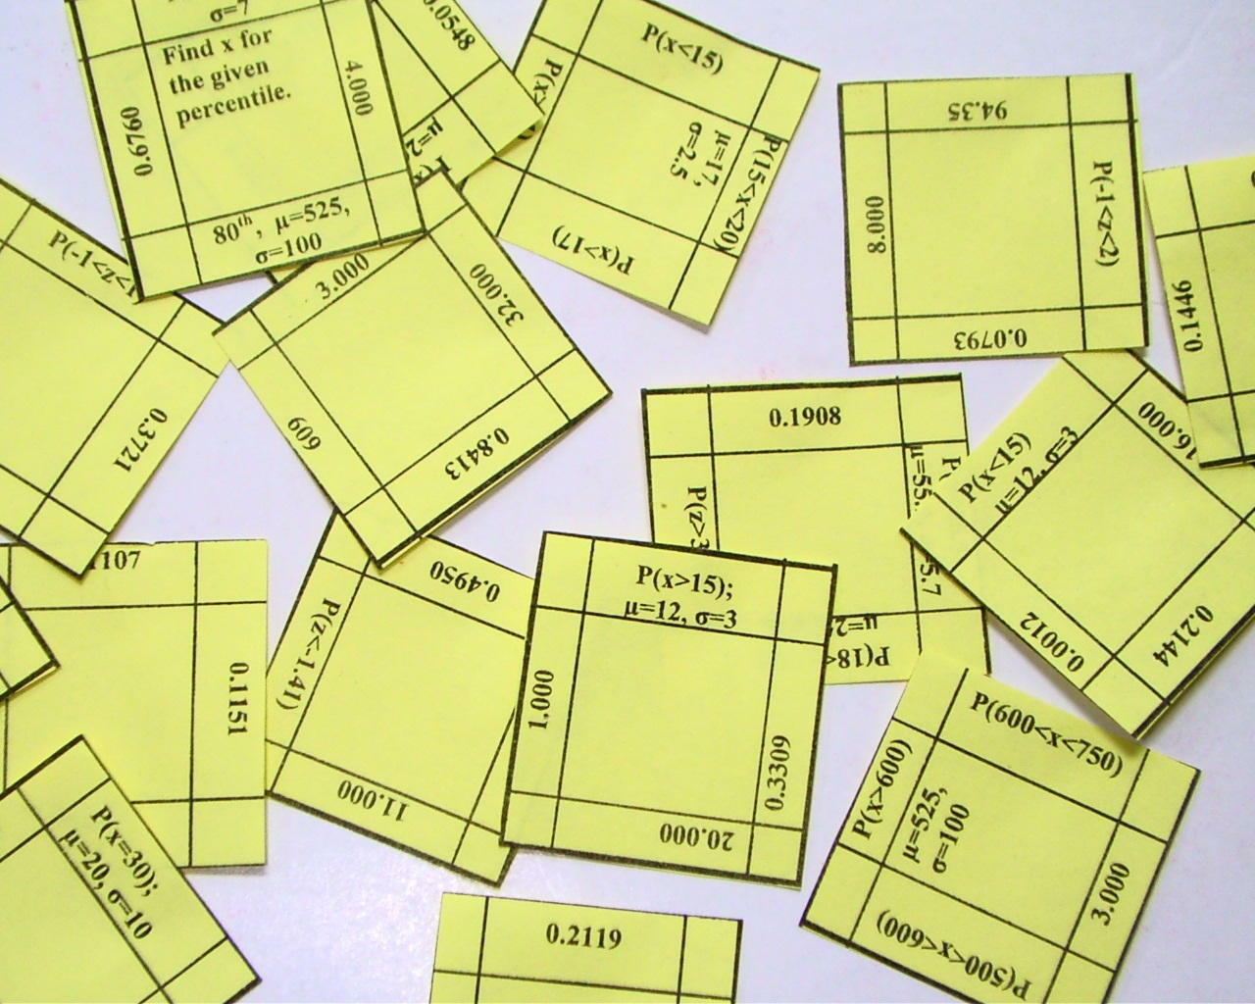
1. Cut out the pieces.

Slide 7
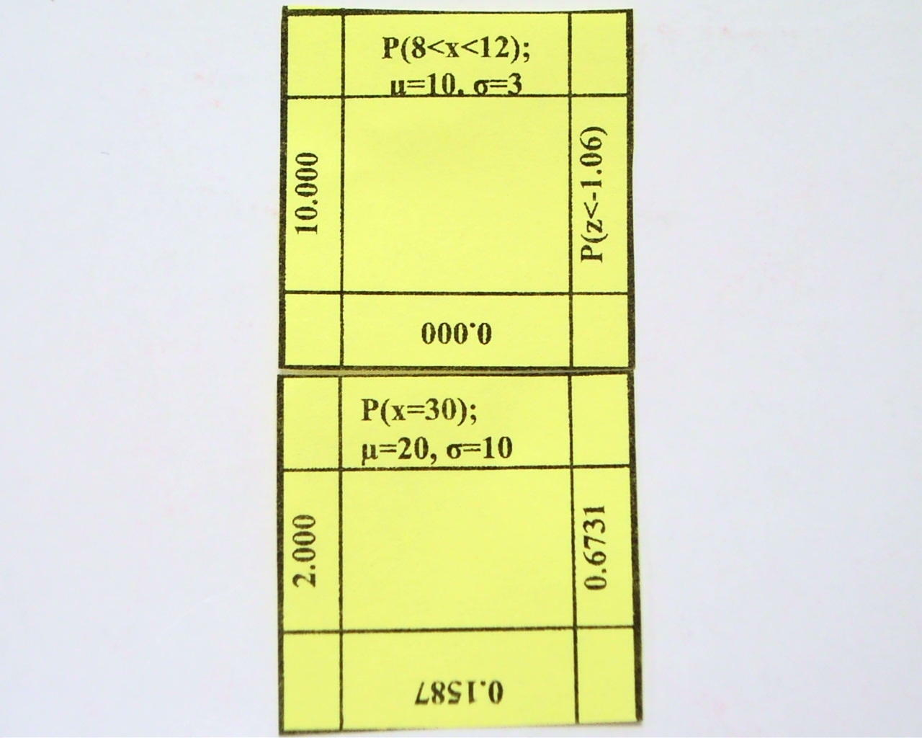
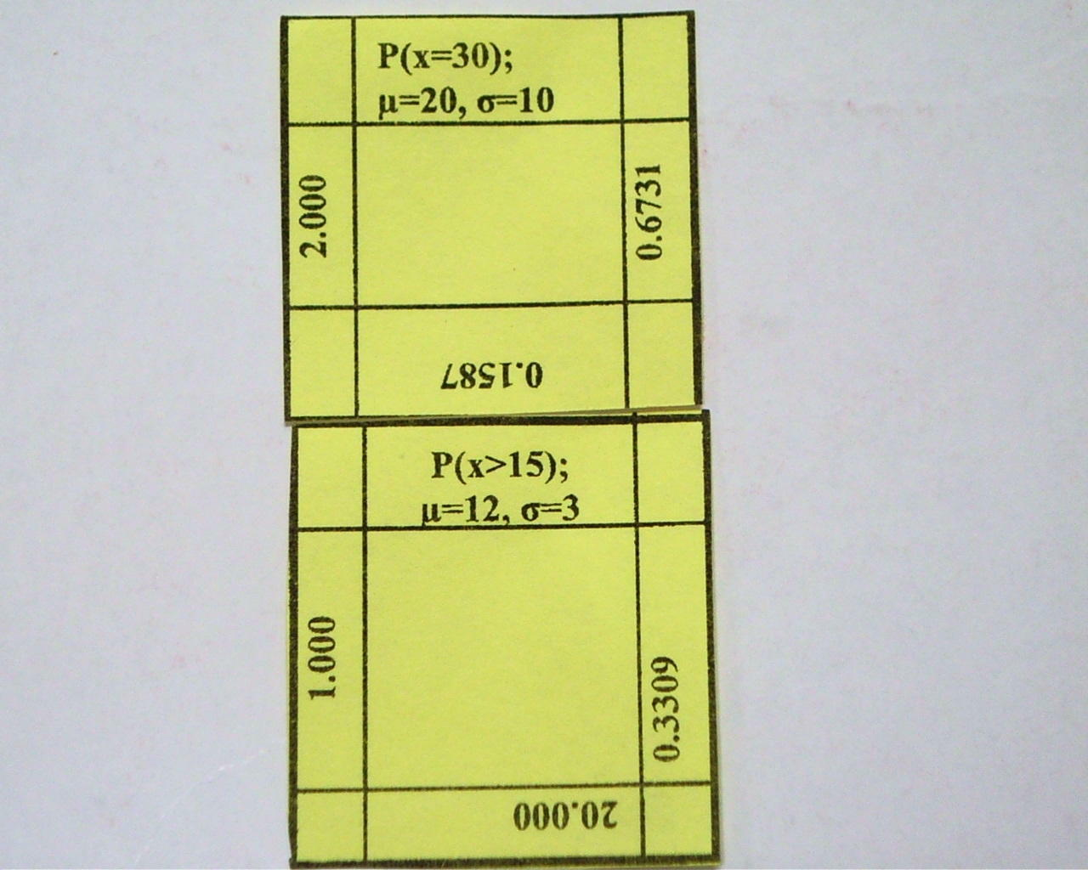
2. Solve a problem and match problem with answer.

Slide 8
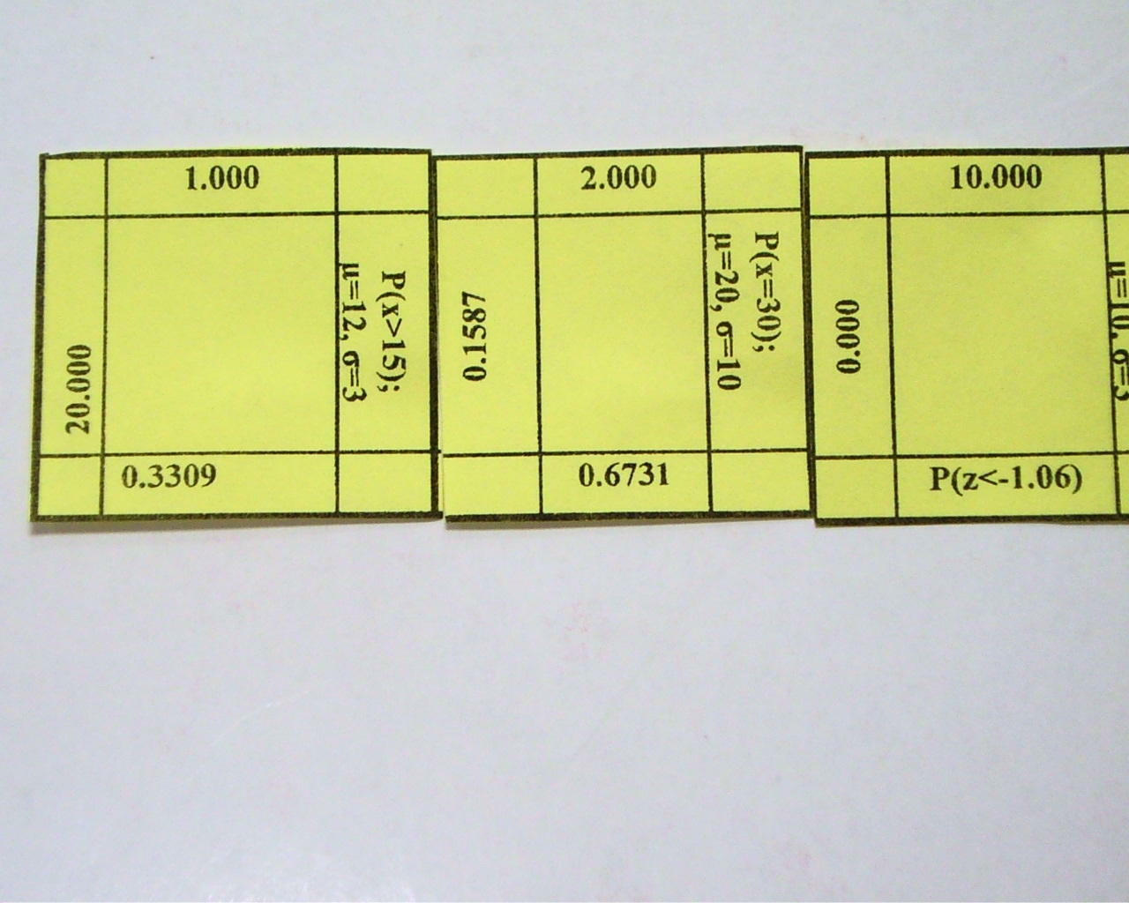
3. Continue matching…

Slide 9
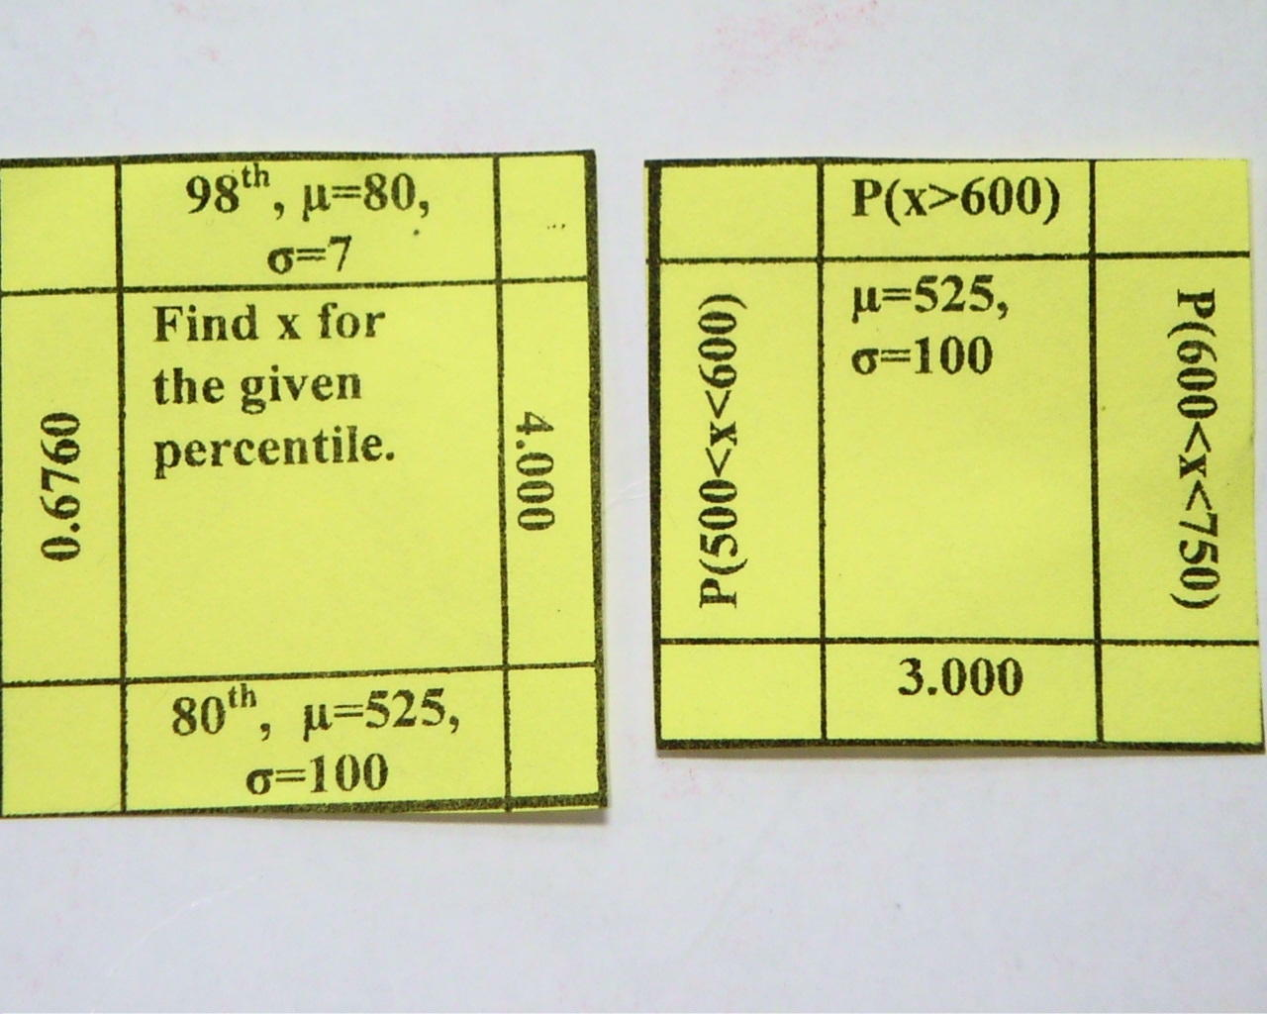
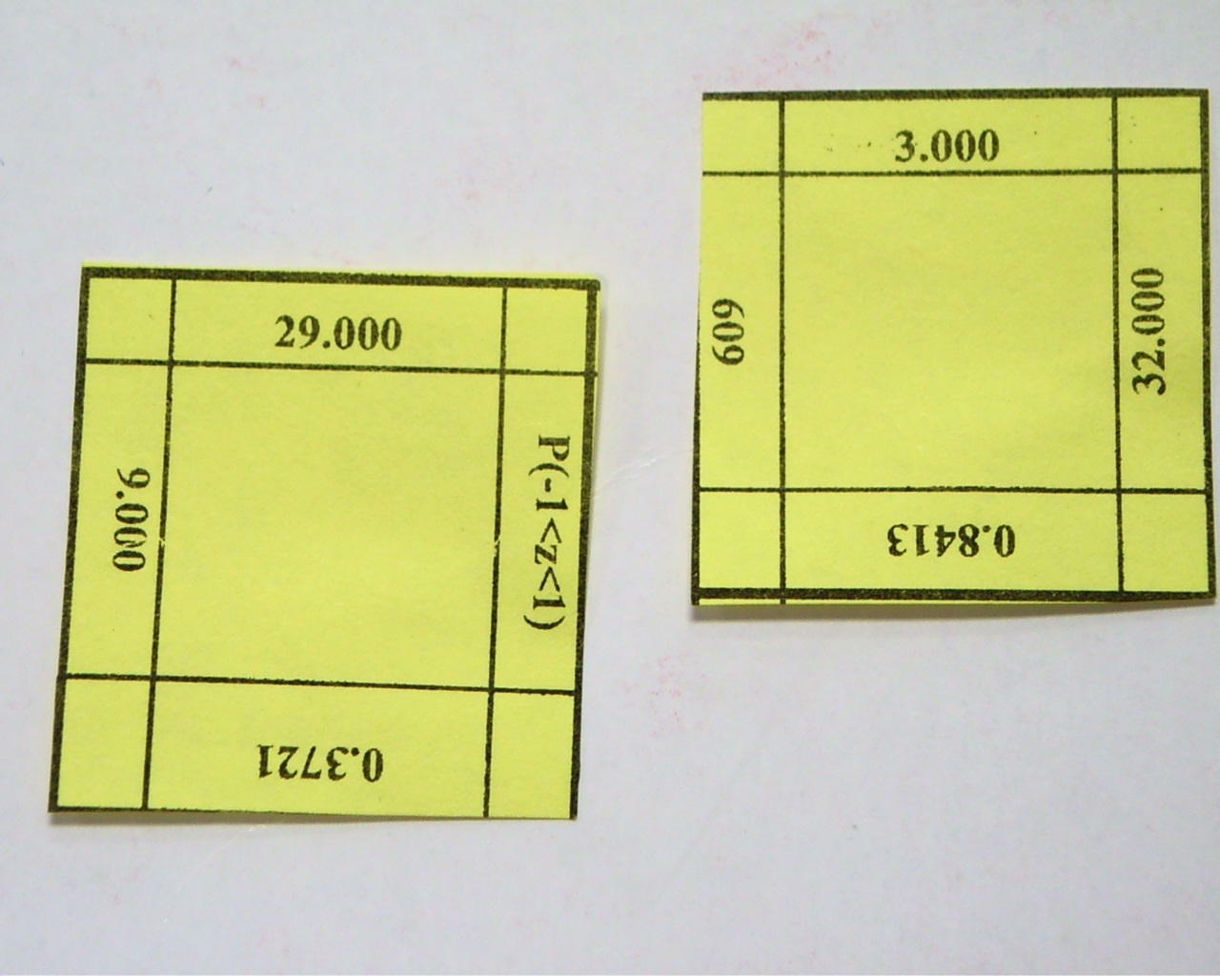
Pieces with Special Instructions:
Shared Instructions
Corner Pieces

Slide 10
4. Finished!

