Slide 1
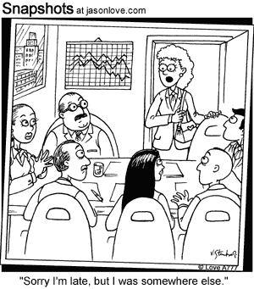
ap statistics
FRAPPY! 10

Slide 2
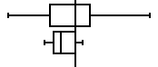
ideal solution part a
students
teachers
-4.5
0
5
students teachers
-4.5 -2
-1.75 -1.5
0 -1
1 0
5 0.5
Min
Q1
Med
Q3
Max

Slide 3
assessing part a
Essentially correct (E): If parallel boxplots are correctly drawn including labels (student and teacher) and shows a common scale. If only one group is labeled, we’ll infer the correct label for the other group. The five-number summary is not required but may be used to compensate for an incorrectly placed point on a boxplot.

Slide 4
more on a
Partially correct (P): if there is only one error (e.g. omitting labels and/or scale, showing outliers, highly inconsistent scale, one misplaced point or reversing labels).
Note: two separate boxplots are acceptable as parallel plot providing the scales for the two plots are the same so that comparison can easily be made.

Slide 5
ideal solution part b
The teachers’ watches tend to have times that are closer to the true time. Although the teachers’ watches tend to be slow, the times are less variable than the student times and so more teachers’ watches had times that were close to the true time.

Slide 6
assessing part b
Essentially correct (E): if teachers are picked based on some form of variability (e.g. range, compactness, IQR, spread, min-to-max, etc.)
Partially correct (P): if either teachers are selected with an incorrect explanation or no explanation. OR… “students” are selected based on center

Slide 7
ideal solution part c
Testing this pair of hypotheses will not answer the teacher’s question. The mean amount of time by which student watches differ from the true time could be zero even when student watch times differ greatly from the true time if large positive differences are offset by large negative differences.

Slide 8
assessing part c
Essentially correct (E): if the response says that testing these hypotheses will not answer the question posed and a plausible explanation is given. Plausible explanations should focus on things such as: positives and negatives cancelling out, individual times versus group averages or variability. Reference to the boxplot is not expected.

Slide 9
still assessing c
Partially correct (P): if the answer given is “no” and either there is no explanation and part b was scored essentially correct (E).
OR… there is an incomplete or incorrect explanation that addresses the connection (or lack of connection) between the given hypotheses and the teacher’s question.

Slide 10
and more c
Incorrect (I): if the student discusses conditions needed to perform the test do not address the issue of connection.
OR… if the response attempts to change the teacher’s question.

Slide 11
scoring
4 (complete response) EEE
3 (substantial response) EEP
2 (developing response) EEI EPP PPP EPI
1 (minimal response) EII PPI

