Slide 1
Joint AP Statistics & AP U.S. Gov't end-of-year projects
Adam Shrager (AP Statistics)
Paul Tkacs (AP US Government)
Hopewell Valley Central High School
Pennington, NJ

Slide 2
The Concept
Combine the two largest AP subjects in the school to do a joint, interdisciplinary project
Between 4-7 weeks after AP exams until graduation.
Students taking both classes designated: Project Managers, take on additional team-leading responsibilities.
True applications of statistical concepts learned. True applications of policy / politics concepts covered.

Slide 3
2011 – Policy Proposal
Students were tasked with selecting from a list of policy issues and answering a question using original data analysis as well as provide policy and historical perspective.
Abortion, Marijuana Legislation, Gun Control, Hydraulic Fracking, Federal Deficit, among others…
Paper, 6 slide presentation, and a joint POLICY SYMPOSIUM with all 100+ students concluded the project, including a graded round-table discussion.

Slide 4


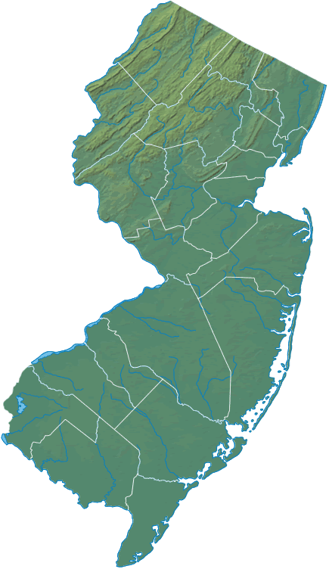
NJ vs. CA:
Alcohol Distribution in Grocery Stores
And
Its Effect on Crime and Death Rates
By Abigail Berkowitz, Kelly MacDonald, Alex Simonian, Ellie Fishman, Hannah Wasserman, and Willa Sweeney

Slide 5
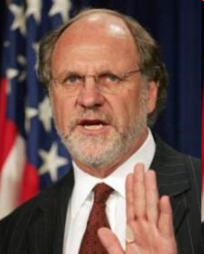
The Situation
When Jon Corzine was governor of NJ, he tried to create financial plan to fix state budget
  Wanted to raise alcohol tax to increase revenue
  Wanted to also simplify alcohol-selling process to increase alcohol sales
Reactions
  Large chain stores support
  Small business worried about increased competition
  Critics of plan say more licenses will not increase sales (fewer licenses now than in mid-1980s, same amount of alcohol sold today)
Bill stalled in Congress
Should New Jersey simplify process of getting a liquor license, so that alcohol can be sold in grocery stores more readily, for example?

Slide 6
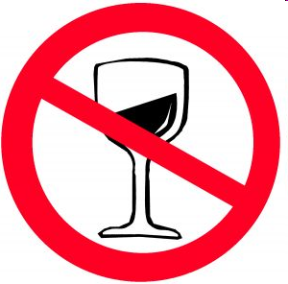
Current New Jersey Policy
Licensure state - the state can issue liquor licenses to private sellers; indirectly controls the sale/distribution of alcohol
No formal ban on selling alcohol in supermarkets, but each chain is limited to only 2 licenses. Liquor must be in a separate department or an attached sister store
Alcohol generally sold from 9:00 AM to 10:00 PM. Most municipalities have a last call of 2 a.m.
  Some larger cities (ex. Newark) close at 3 AM and some serve 24 hours (ex. Atlantic City). Some dry towns are in the southern part of the state- Quaker and Methodist influence
Punishment for alcohol related incidents:
  Public intoxication -- punished by a fine max. of $1,250 and up to 3 months jail time. Sometimes probation and community service
  DUI punishments-- Jail for up to 30 days, loss of license for 3-12 months, fines from $250- $500 and other fees

Slide 7

Current California Policy
California is also a licensure state
Private retail, convenience, and grocery stores can sell alcohol from 6 a.m. to 2 a.m.
Grocery stores are now allowed to distribute free samples of alcohol in the store during business hours
Public intoxication is punished by 1 night in jail and a fine up to $1,000
  6 months probation or community service may be required
DUI punishments are as follows:
  First offense
    Jail from 96 hours to 6 months
    Fine: From $1,000 to $1,600
    License Suspension: 6 Months
  Second offense
    Jail: 90 Days to 1 Year
    Fine - From $1,000 to $1,900
    License Suspension: 2 Years

Slide 8
Statistics
California
2009 DUI arrests: 208,831
2009 total population: 36,961,664
Per capita DUI arrests: .0056
New Jersey
2009 DUI arrests: 27,345
2009 total population: 8,707,739
Per Capita DUI arrests: .0031
In 2009, the per capita DUI arrests in California were significantly higher
California
2009 alcohol traffic fatalities: 950
2009 total traffic fatalities: 3,081
Proportion of alcohol related traffic fatalities: .3083
New Jersey
2009 alcohol traffic fatalities: 149
2009 total traffic fatalities: 583
Proportion of alcohol related traffic fatalities: .2556
In California in 2009, there were significantly more alcohol related traffic fatalities than were found in New Jersey the same year.

Slide 9

Policy Proposal
Recommendation
New Jersey’s stricter rules governing alcohol distribution lower the rate of alcohol-related crimes and deaths
California (and other states with similar policies) should create stricter laws to prevent the distribution of alcohol (specifically in grocery stores) and thus lower those related rates

Slide 10

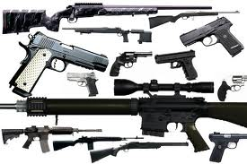
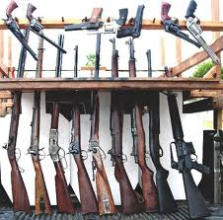
AP Gov/Statistics Symposium: Gun Policy
By: Nigel Bates, Ali Falcone, Libby Ordonez, Dylan W-F, Cait Williams, Charlie Yu

Slide 11

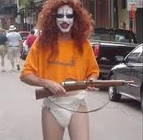
Current US Policy
2nd Amendment: right of the people to keep and bear arms
Regulations vary by state
Restrict minors and other persons lacking specific qualifications from possessing firearms

Slide 12
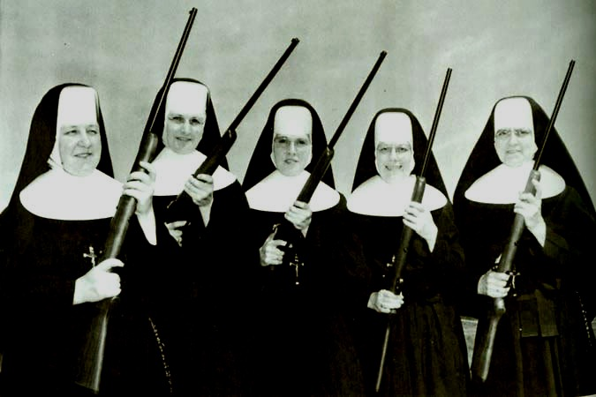

Canada’s Policy
Pass the Canadian Firearms Safety Course
Get a friend/family member to sign form validating
Pay $80 fee that is good for 5 years
Minors from age of 12-17 are able to possess and use firearms with signed parental consent

Slide 13
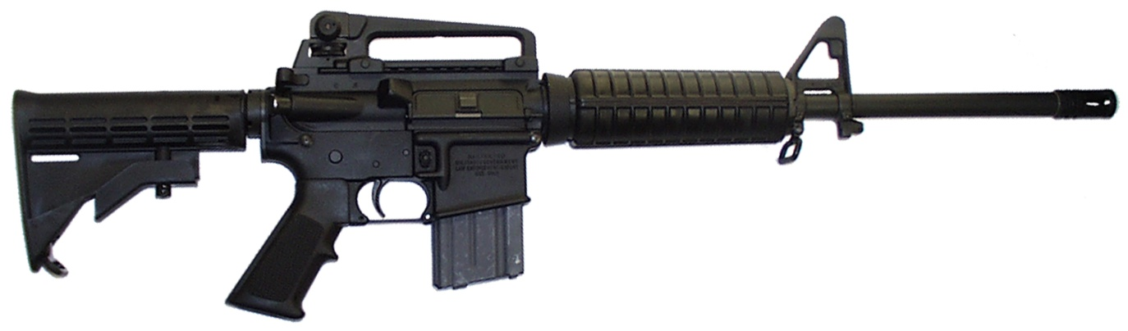
Statistics
We ran a one-tailed 2-sample T-test:
  Null hypothesis (H₀): µ₁ = µ₂
  Alternate hypothesis (H_{a}): µ₁ < µ₂, where µ₁ is the true mean number of yearly gun deaths per 100,000 people in Canada and µ₂ is the true mean number of yearly gun deaths per 100,000 people in the United States.

Slide 14
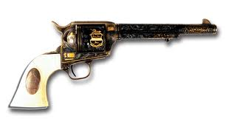
Statistics
Canada:
  mean number of gun deaths per 100,000 people was 5.286, with a standard deviation of 0.522
US
  mean number of gun deaths per 100,000 people was 14.216, with a standard deviation of 0.701
The t-statistic obtained for this test was -38.236. This corresponds to a p-value so small that it can be safely rounded to 0

Slide 15
New Policy
Adopt Canada’s rules and regulations concerning firearm ownership and use!

Slide 16
2012
Presidential Election Predictions
Shorter time frame (3 ½ weeks)
Students were assigned one swing state (margin of victory in 2008 < 6%)
13 swing states plus a couple more, students made predictions for 16 states.
Students analyzed vote, voter registration, demographics, congressional races, and other statistics in their assigned state.
Students also considered policy issues relevant to that state.
We will be tracking our predictions in a Facebook group.

Slide 17
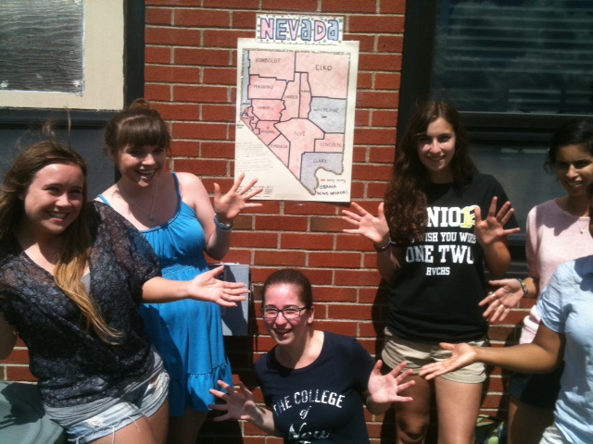
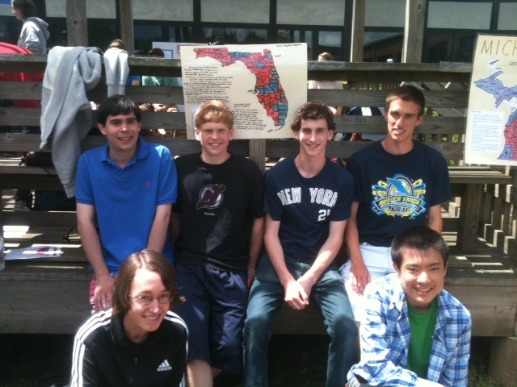

Slide 18
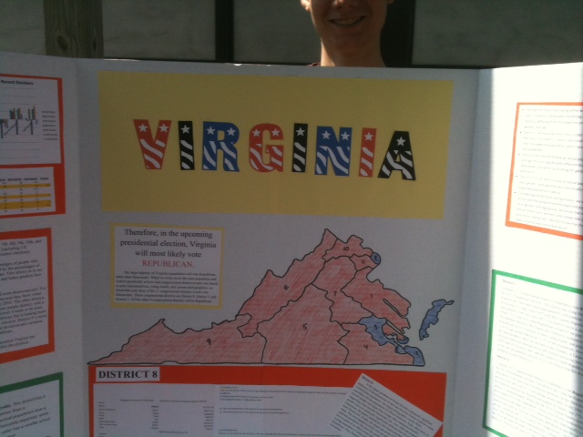
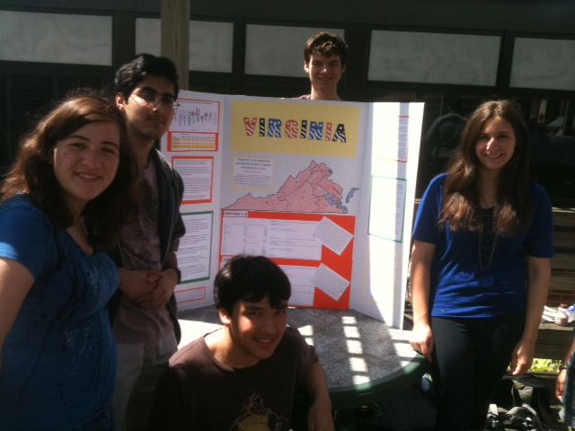

Slide 19
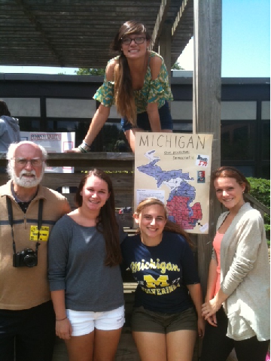
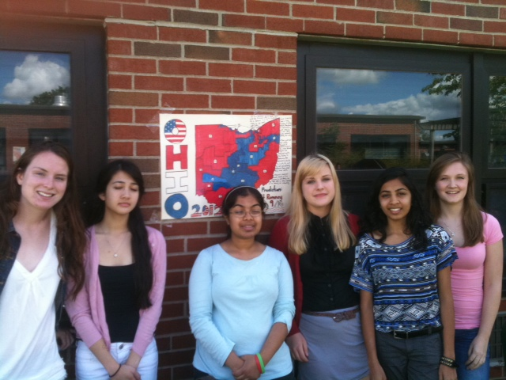

Slide 20
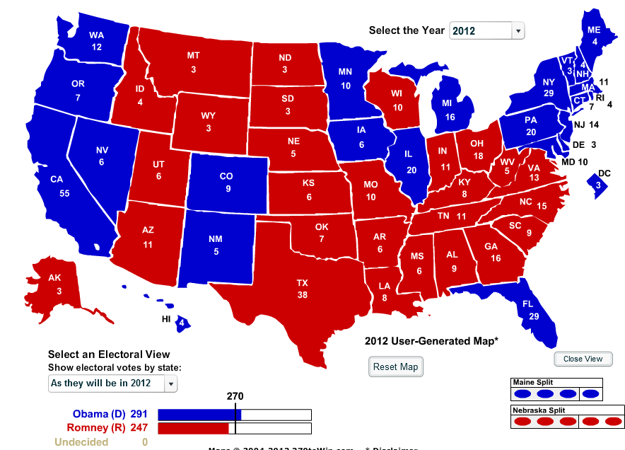
Obama – 291, Romney - 247

