Slide 1
“r” is Not Enough
Ashley Schreckengost
Wheaton High School
Silver Spring, MD

Slide 2
Wheaton High School
Demographics of my school
54% Hispanic, 26% African American, 8% Caucasian
78% FARMS (free and reduced meals)
50% of students have been ESOL at some point during their school years.

Slide 3
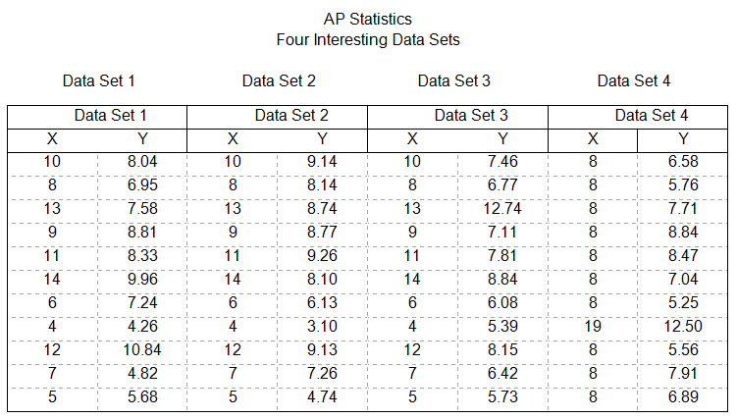
Day 1 of Assignment

Slide 4
Drive the Students a Little Crazy

Slide 5
Students Come in Unhappy☺
Introduce the idea of a residual
Give notes, examples, etc

Slide 6
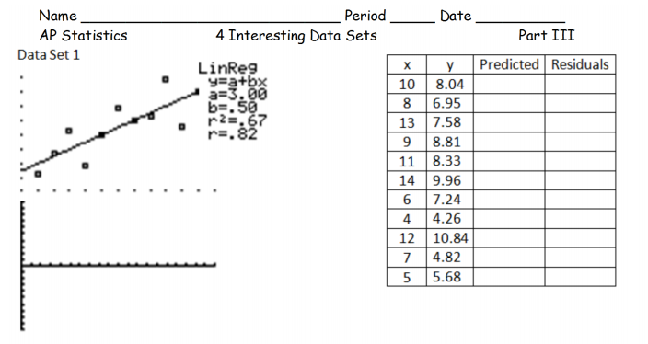
Day 2 or 3

Slide 7
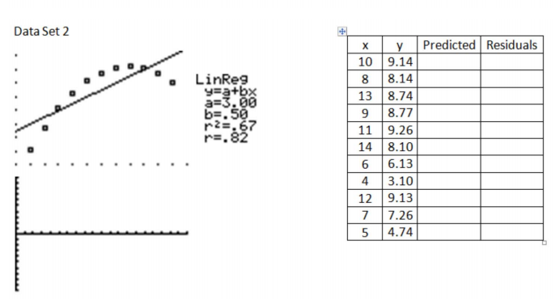

Slide 8
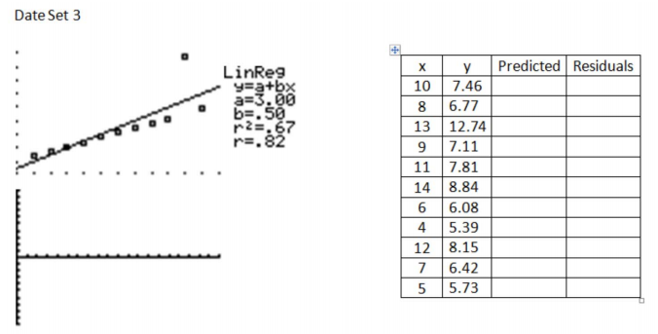

Slide 9
