Slide 1
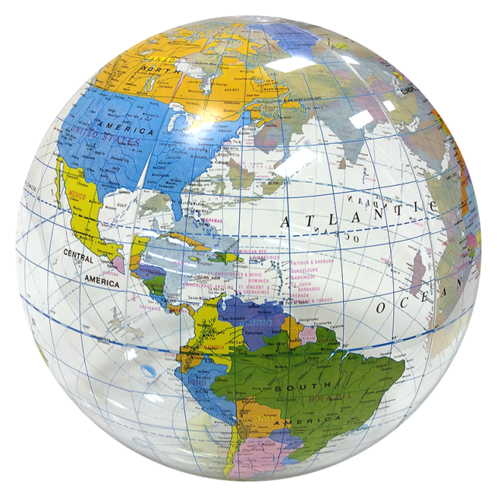
Around the World in 80 Tosses Introducing Hypothesis Tests By Tossing a Beach Ball
Lisa Brock, West Forsyth High School
lbrock@forsyth.k12.ga.us
Carol Sikes, South Forsyth High School
csikes@forsyth.k12.ga.us

Slide 2
Credit
We first learned of this activity at a workshop facilitated by Paul Meyers. He isn’t sure where it originated.
Materials & Time
Materials:
Inflatable Globe
Available from many sources, here’s one with a variety of options:
http://www.beachballs.com/globe-beach-balls.asp?gclid=CP66jcDz4cUCFQcyaQodBEUAHQ
Marker
Time:
10 minutes to collect data
30 – 40 minutes to walk through steps of the hypothesis test

Slide 3
Before Tossing the Globe
Ask the class the question: How much of the Earth’s surface is covered with water?
Use the first student’s response as the claim. (Later the null hypothesis.)
Once a student’s claim has been established, ask the rest of the class if they agree. If not, do you think the claim is too low, too high, or just wrong? (This will establish the alternate hypothesis.)

Slide 4
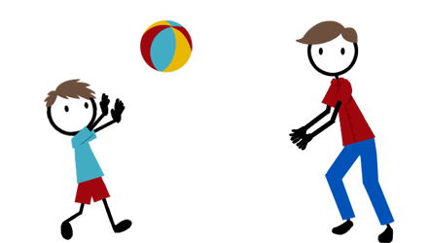
Data Collection
Each student should put a dot in pen on the center of the thumb of their dominant hand.
Toss the globe to a random student and ask them to report whether or not their “thumb dot” is touching land or water.
Have the students continue tossing the globe around the room to each other, indicating where the dot landed.
Record a frequency table on the board for water versus land as the students randomly toss the globe to each other throughout the room.
Collect at least 80 observations. (should result in np and n(1-p) both being > 10).

Slide 5
Linking to a Hypothesis Test
Use the activity data to walk students through a hypothesis test:
Translate original claim and class response into appropriate hypotheses
Link probability calculation to sampling distribution of p-hat with n = # of tosses
Check the conditions related to the shape, center, and spread of the sampling distribution
Perform the probability calculation
Discuss what the probability means – “Is this likely to have happened if the claim was correct?”
Link to the decision

Slide 6
Some Things to Note
We teach hypothesis tests before intervals – immediately following sampling distributions – this makes the calculation of the p-value in this way very natural to the students.
If your original claim is fairly reasonable, it is likely you will fail to reject the null.
Data collection can vary greatly in this activity, so encourage students to toss the globe far enough to “randomize” the outcome and to look carefully at where the dot actually landed.
HAVE FUN!! (The kids usually do ☺)

