Slide 1
Developing Partnerships with an AP Statistics Practice Exam
Christy Brown, Clemson University
Beth Johnson, George Mason University

Slide 2
Clemson Schedule:
 | Students | AP Teachers & Graders
9:00-10:30am | Free Response Test | Rubric Training
10:30-11:00am | Water Break | Grading…
11am-12:30pm | Multiple Choice Test | Grading…
12:30-1:30pm | Pizza Lunch/Explore Campus | Grading…
1:30-2:30pm | Rubric Presentation | Grading/Present Solution
2:30pm | AP Teachers pick up graded exams & score reports
*This year, 11 participating high schools brought 160 students
*There is no cost to participate in the practice exam

Slide 3
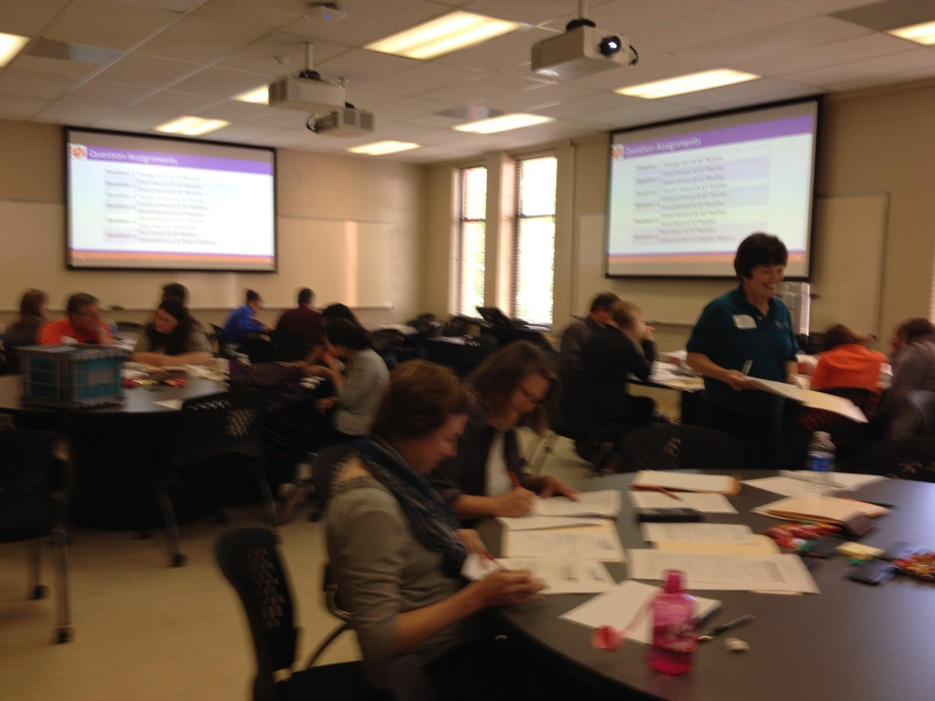
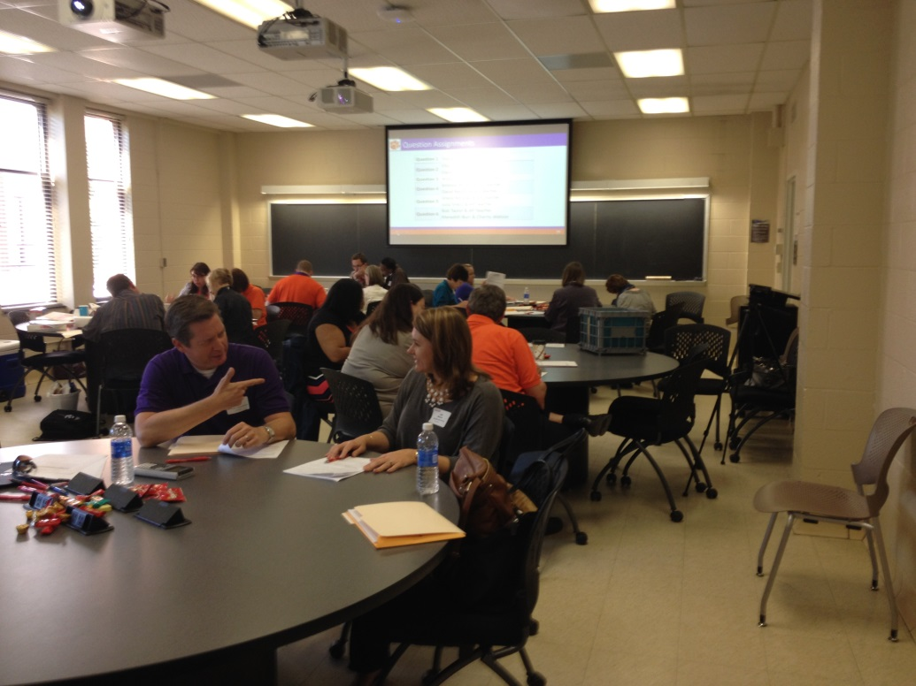

Slide 4
George Mason Schedule:
The participating AP teachers receive rubric training as the students are taking the practice exam
The multiple choice items were machine scored and AP teachers graded four of the six items on site and returned to their schools to grade the remaining items
There is also time for the participating teachers to discuss issues related to the AP Statistics curriculum
This year, 8 participating high schools brought 160 students

Slide 5
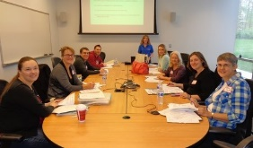
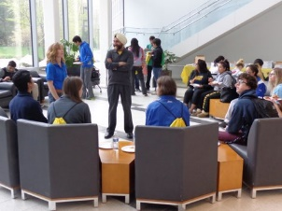
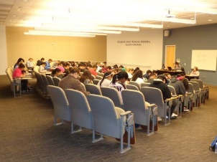

Slide 6
History of the AP Stats Practice Exam:
Started by John Spurrier at the University of South Carolina in 2002 and Beth took over the event in 2006
Clemson University held their first practice exam in 2012
In 2015, six different institutions hosted a practice exam
George Mason University
Clemson University
The University of North Carolina – Wilmington
The University of North Carolina – Charlotte
AP Stats Professional Learning Community in Athens, GA
The University of Delaware

Slide 7
Benefits:
The students receive the benefit of an authentic test day experience and feedback to help them better prepare for the AP exam.
The AP teachers receive the benefit of working with experienced AP graders and networking with other AP Statistics teachers located at nearby high schools.
The college faculty receive the benefit of a better appreciation of the AP curriculum, the AP exam, and the AP teachers.

Slide 8
Developing Partnerships:
Between AP teachers located in the same region
Between universities and nearby high schools
Between institutions hosting their own practice exams

Slide 9
Exam Writing:
A new practice exam is written every year so that AP teachers can have items to use on their future classroom tests
Writing assignments by topic are sent to the participating institutions in the Fall semester
Items are due near the beginning of the Spring semester
Christy compiles the questions and formats the exam
All participating institutions have the chance to provide feedback
Christy incorporates the feedback into a second draft

Slide 10
Contact Info for Participating Institutions:
George Mason University in Fairfax, VA
Contact: Beth Johnson, ejohns40@gmu.edu
The University of North Carolina – Wilmington
Contact: Jonathan Duggins, prime.duggins@gmail.com‎
The University of North Carolina – Charlotte
Contact: Lew Davidson, lewis.davidson@cms.k12.nc.us
AP Stats Professional Learning Community in Athens, GA
Contact: Dione Maxwell, dmaxwell@walton.k12.ga.us
The University of Delaware
Contact: Bryan Crissinger, crissing@udel.edu

Slide 11
Contact Info for Participating Institutions:
Clemson University in Clemson, SC
Contact: Christy Brown, cjb2@clemson.edu
Email Christy if you are interested in hosting your own practice exam or if you are interested in helping to write items for the next practice exam!

