Slide 1
Confidence Level Through Motion
Ashley Schreckengost
Wheaton High School
Silver Spring, MD

Slide 2
My School
79.9% currently or at some point have been on Free and Reduced Meals (FARMS)
56.5% Hispanic, 23.4% Black, 9.5% Asian and 8% White
56% have been ESOL at some time.
18% Mobility rate
13% Special Education

Slide 3
Confidence Level Through Motion
Activity:
  Students are each given a snack size bag of skittles where students find the proportion of green skittles in their bag.
  Students then create a 68% confidence interval.
  Students who capture the true value of 20% stand on one side of the room and students who do not capture it stand on the other.

Slide 4
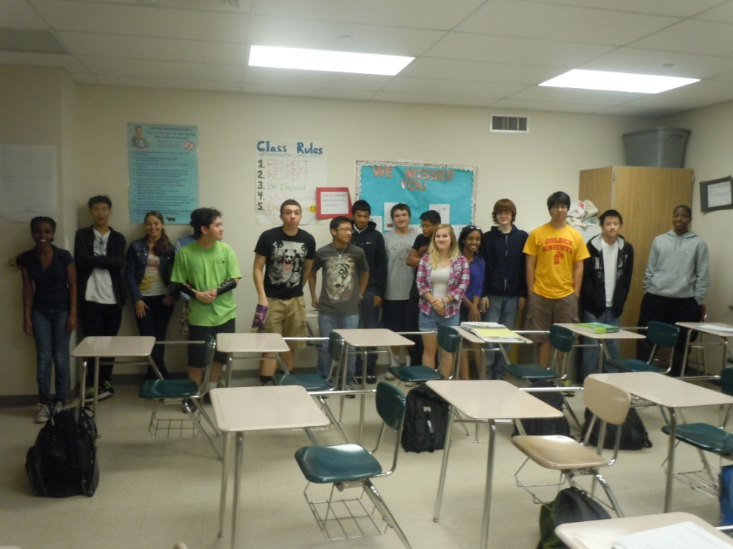
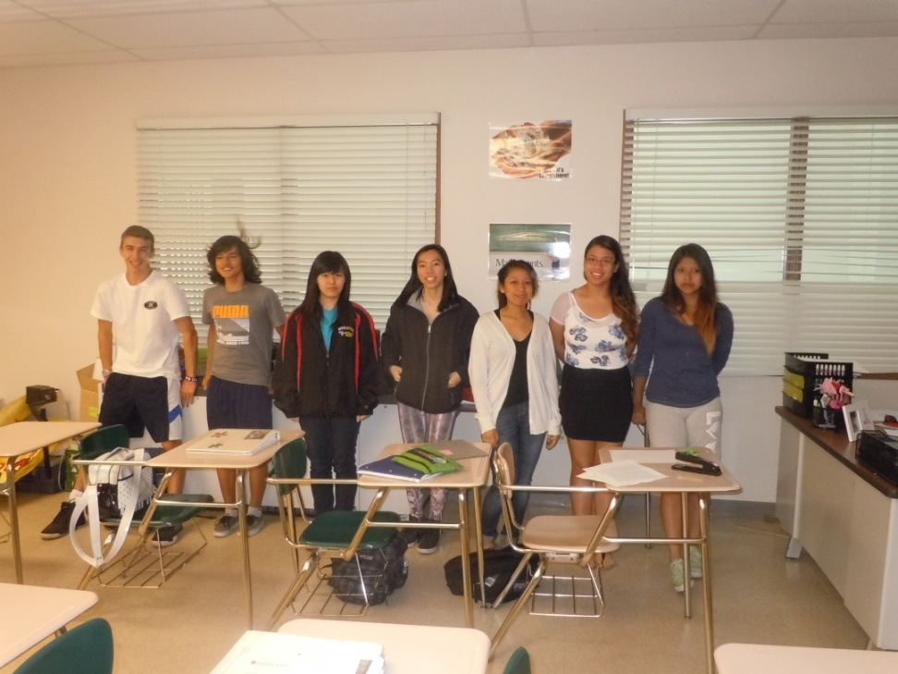
68% confidence Interval

Slide 5
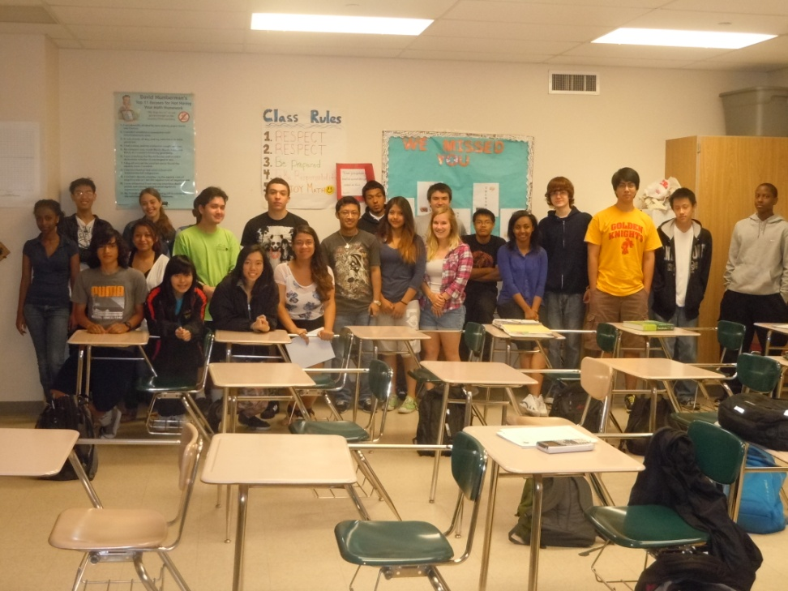
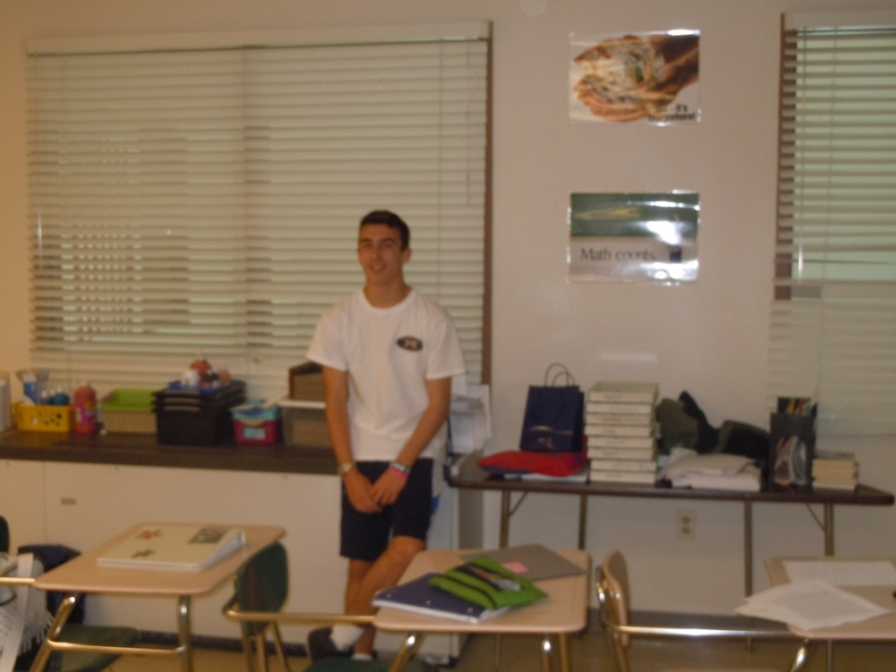
95% Confidence Interval

Slide 6
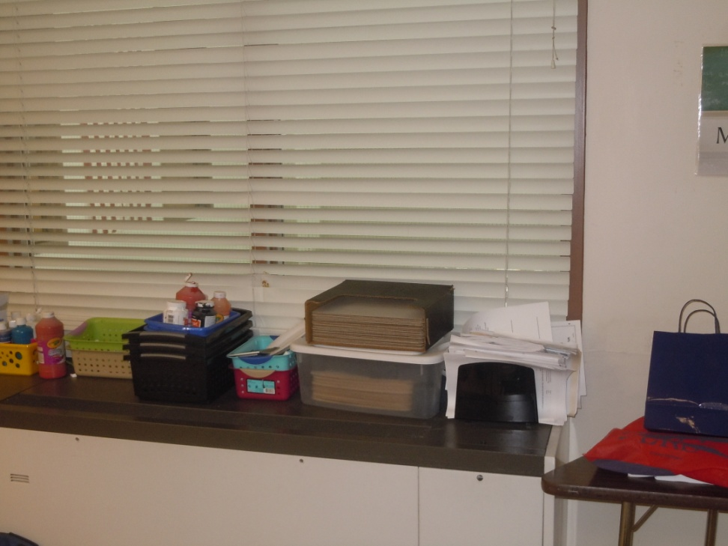
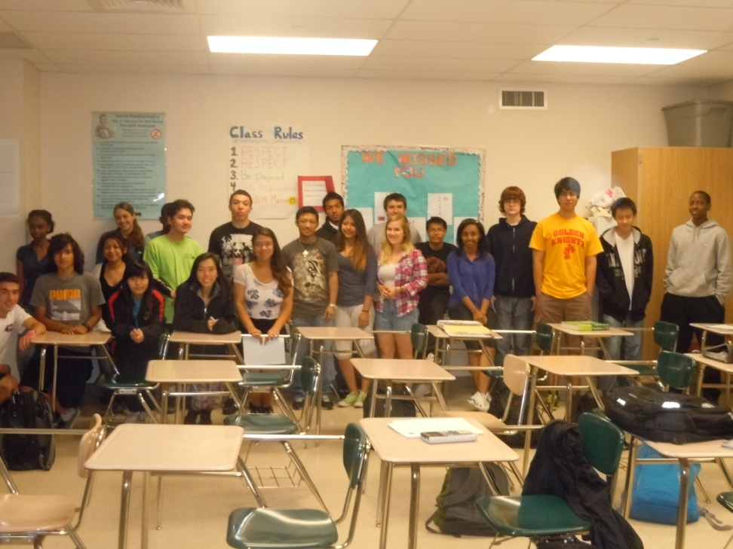
99% Confidence Interval

Slide 7
What this Activity Accomplished!
My students could actually “see” what confidence level meant.
We referred back to the motion of students around the room even up until the day before the AP exam.
It was incredibly clear the difference between confidence level and confidence interval.

