Slide 1
FRAPPY BUNNIES!!
Joshua Sawyer
Northeastern High School
Elizabeth City, NC
mrsawyermath@gmail.com

Slide 2
The Issue:
Finding ways of gaining authentic data
Not having to rely solely on pre-fabricated information
A novel way of getting data in preparation for AP exam

Slide 3
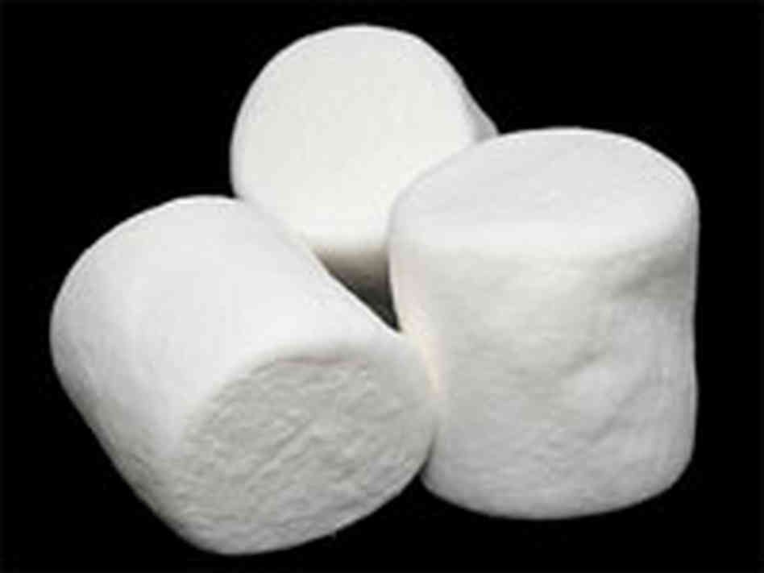
The Solution

Slide 4
Benefits of Using Marshallows
Cheap
Engaging
Entertaining
Memorable

Slide 5
The Process
Students decide on important variables
Height
Weight
Gender
Braces/Nah
Wisdom Teeth?
Also, prediction vs. actual

Slide 6
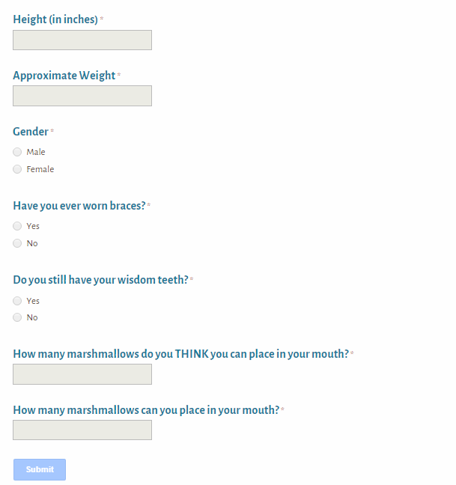
Data Collection
Google Form

Slide 7
Data Analysis
Each group given a different set of variables to analyze
One variable analysis
Two variable analysis
Regression
Chi-squared analysis

Slide 8
Lessons Learned
Small data set – less variation
Competition may affect data (principal story)
Make sure to bring plenty of napkins and trash bags
Take plenty of pictures

Slide 9
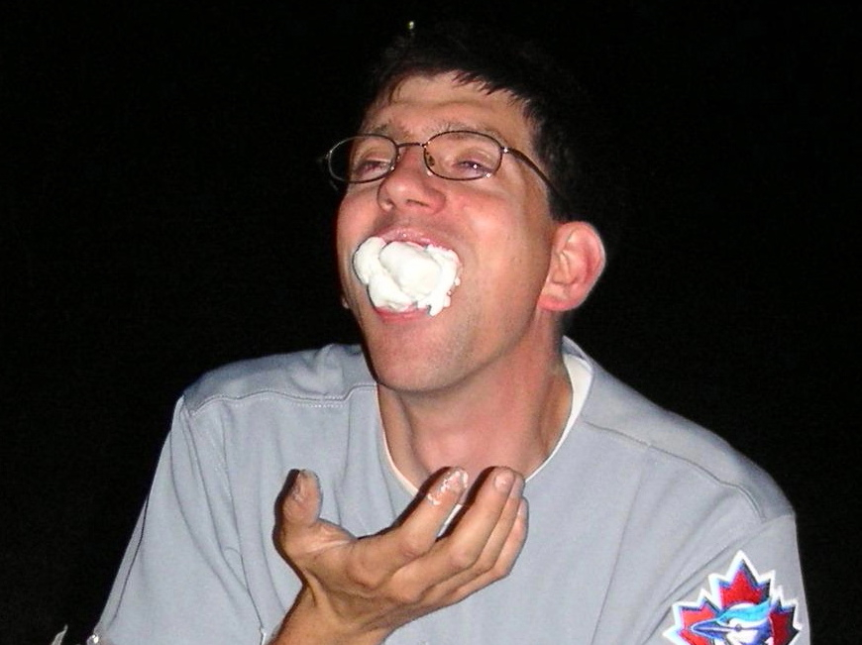
Guy with a lot of marshamallows
Source: Wikipedia

Slide 10
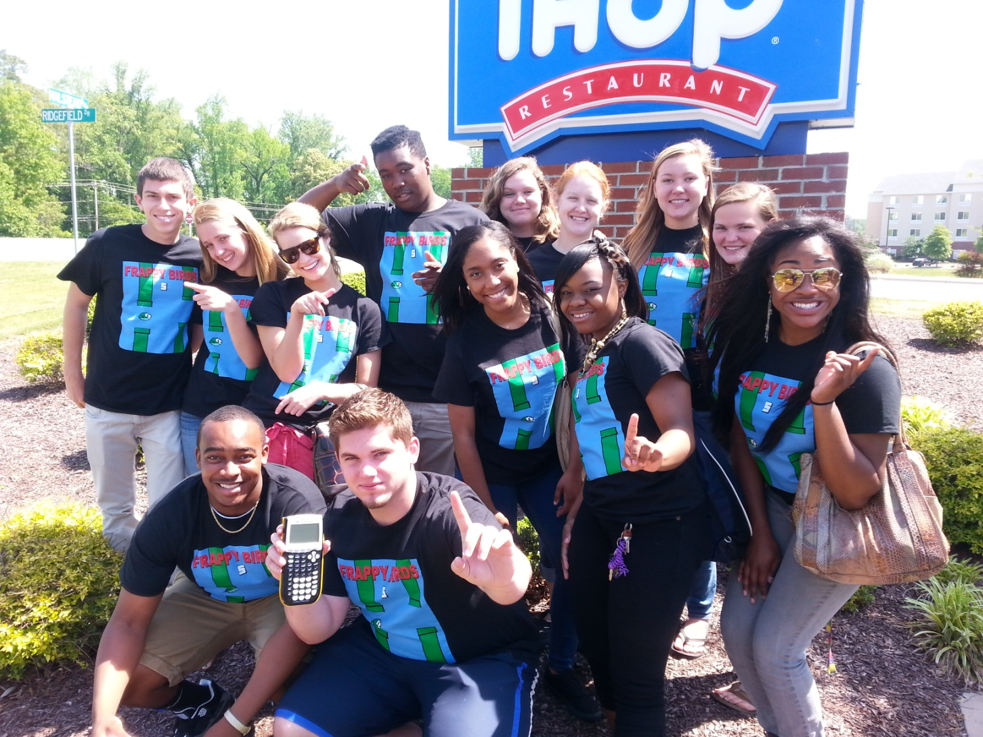
The Usual Suspects

Slide 11
Thank you!
Thank you for your time and attention.
mrsawyermath@gmail.com
Google Form:
https://docs.google.com/forms/d/1Jt-RJbHjEjUmB2tK3MNjyWdPAGUrcniBJX4JXsFmblk/viewform

