Slide 1
Research Team: Assemble!
Brandon Hanson
2013 AP Statistics Reading Best Practices

Slide 2
Motivations for program
Statistical literacy is an important goal for all students.
Students need opportunities to do statistics. I need to avoid doing it for them.
Guiding questions
How would a statistician do statistics?
What would benefit my students regardless of their career choices?

Slide 3
Overview of curriculum
Designed to be a year-long course where each phase would take about 9 weeks.
Phase 1: Descriptive Statistics
Phase 2: Surveys and Samples
Phase 3: Formal Inference
Phase 4: Experiments

Slide 4
Description of class
20 students
19 Seniors
1 Junior
Standard-level class
Honors and AP also offered at school
Modified block schedule
One 45 minute class per week
Two 90 minute classes per week

Slide 5
Phase 1: Descriptives
Students were to use descriptive statistical methods to analyze variables related to their school.
This phase consisted of four sections.
Part 1: Variable Selection
Part 2: Variable Refinement
Part 3: Collection Protocols
Part 4: Collecting the data

Slide 6
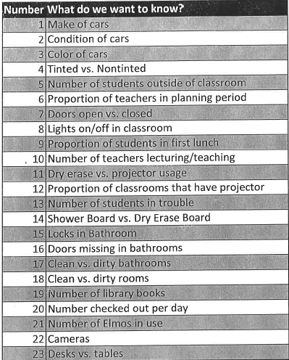
part 1: Variable Selection
Students initially chose 23 variables related to school.
Both quantitative and qualitative were chosen.
The top four were selected for research.
Make of cars on campus.
Color of cars on campus.
Proportion of teachers who keep their classroom doors open.
Proportion of classrooms that have tables instead of desks.

Slide 7
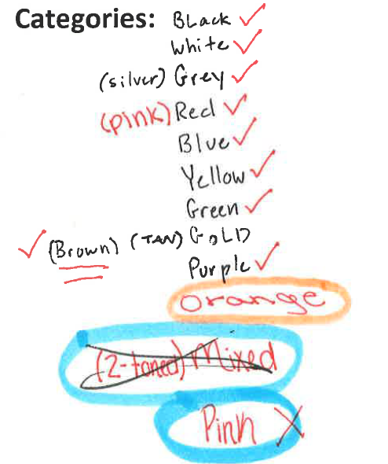
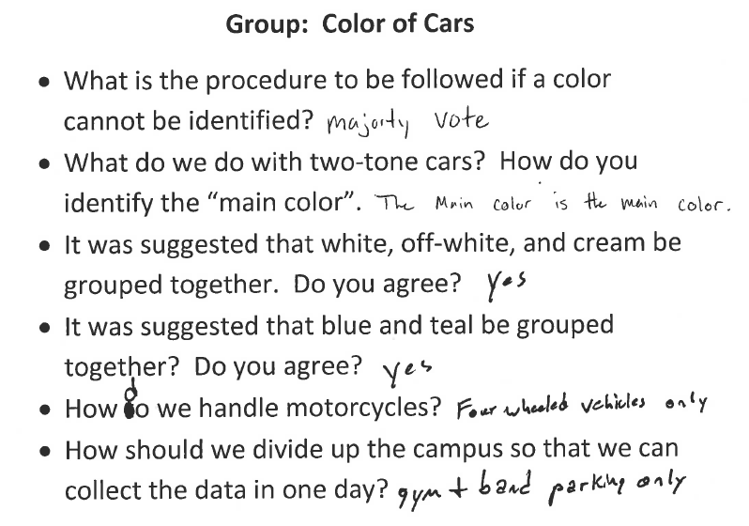
Part 2: Variable Refinement
One group per variable
Each group had to clearly identify the variable of interest and list all possible outcomes for the variable.
The other groups created a list of questions about the data collection process.
Each group had to discuss and answer the questions related to their variable.

Slide 8
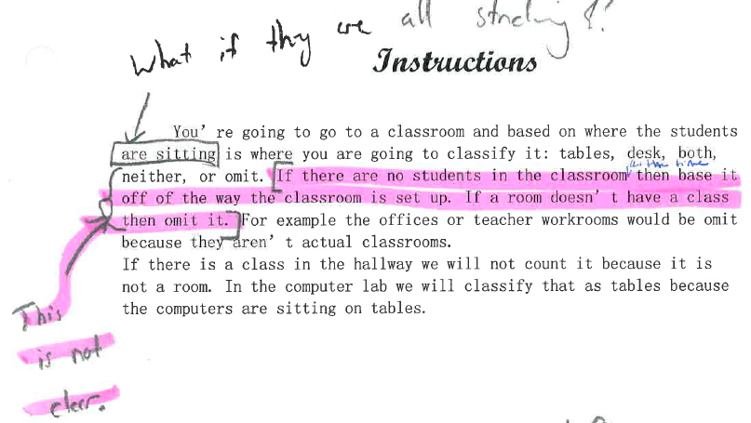
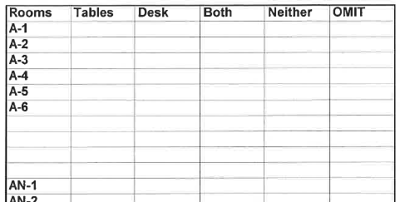
Part 3: collection protocols
Each group created a protocol that included the following:
Clear definition of variable
Clear details of all possible values/categories
Clear instructions on how to collect the data
Data collection forms
Students and teacher made suggestions for revisions.

Slide 9
Part 4: collecting the data
Using the protocols, six groups collected the data for the variables.
Each variable took approximately one hour.
SURPRISE! There were some complications.

Slide 10
Phase 2: Sampling and surveys
Main Question: If the presidential election were in the hands of RHS students, who would win?
This phase consisted of six sections.
Part 1: Survey Design
Part 2: Sample Design and Selection
Part 3: Data Collection
Part 4: Data Coding
Part 5: Data Analysis
Part 6: Conclusions

Slide 11
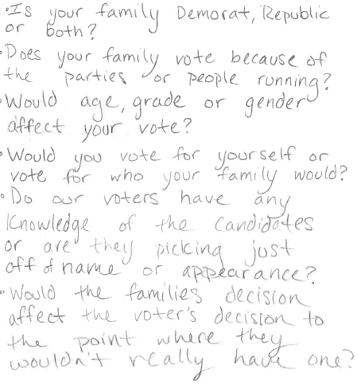
Part 1: Survey Design
Main Question: How would Riverdale students vote in the upcoming presidential election if they could vote?
Students were asked to consider any additional variables that might help them understand voting preference.
They chose the following:
Gender
Grade
Age
Race
SES (measured by free/reduced lunch)
Parental influence

Slide 12
Part 2: Sample Design and Selection
Initially, the students wanted to purposely select various classrooms, but this proved difficult.
The class decided to take a cluster sample of the school.
Eighteen teachers were randomly selected from a pool of those that did not have 7th period planning.
The teachers were solicited via e-mail and all but one agreed to allow their students to be sampled.

Slide 13
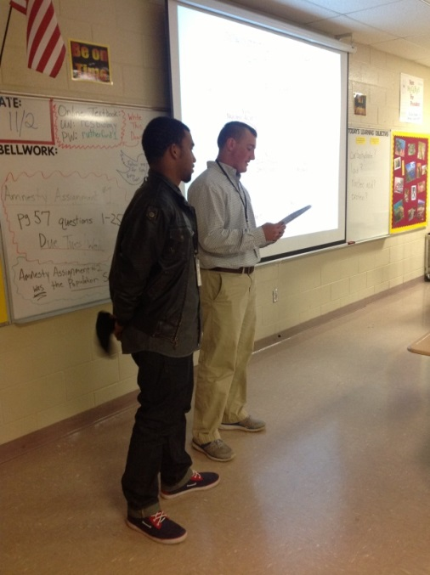
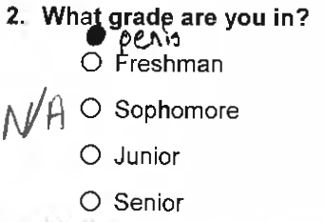
Part 3: Data Collection
269 students were sampled.
2 members of the research team surveyed each class.
Each student was given a seven question survey and written instructions.
Irregularities were encountered and reported post collection.

Slide 14
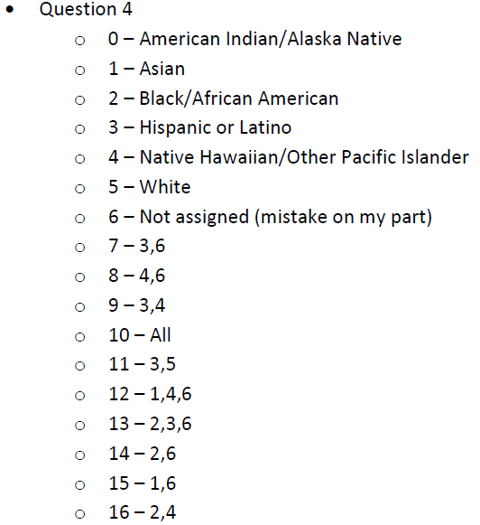
Part 4: Data Coding
Student created a coding scheme for the surveys.
Numerical codes were assigned to each answer on the survey.
New codes had to be created to account for students selecting multiple options or leaving questions blank.

Slide 15
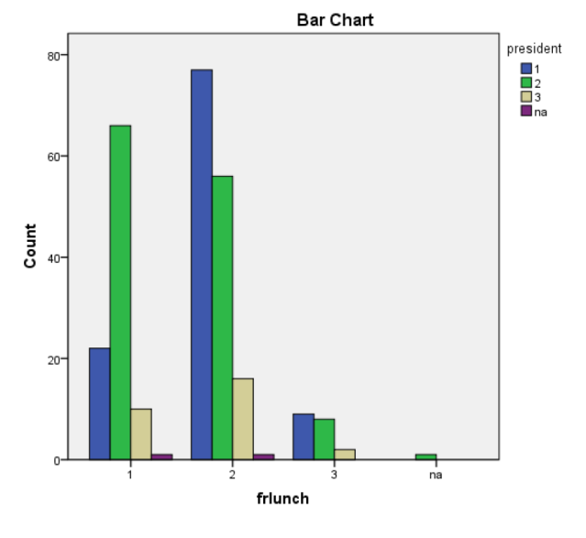
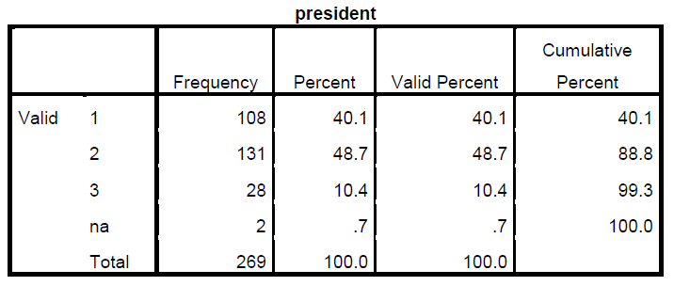
Part 5: Data Analysis
I provided students with basic descripitves, crosstabuations, and results from chi-square tests.
Note that the latter required some discussions of p-value.

Slide 16
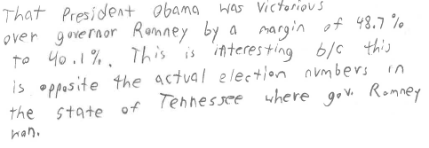
Part 6: Conclusions

Slide 17
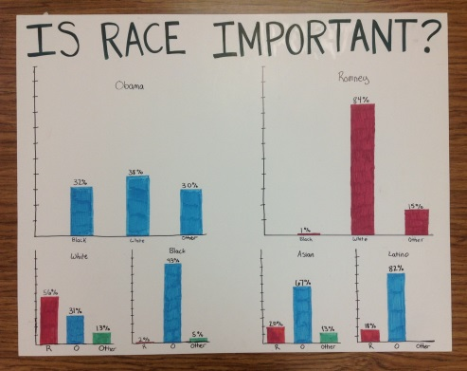
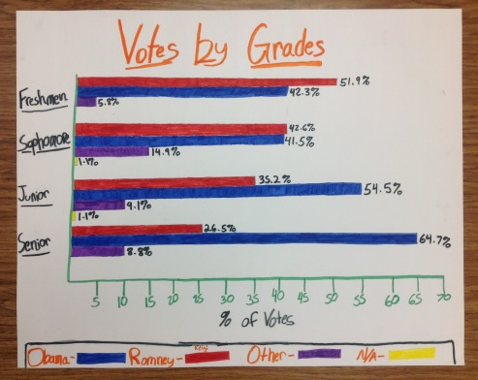
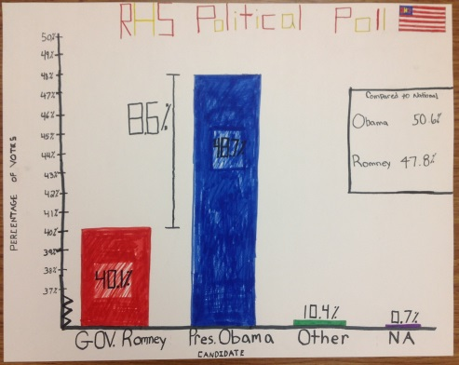
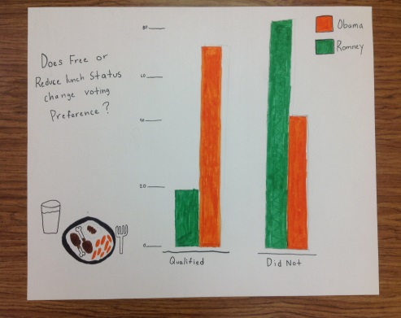
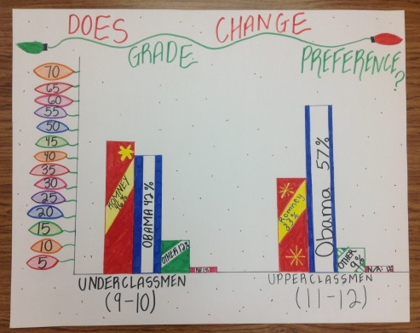
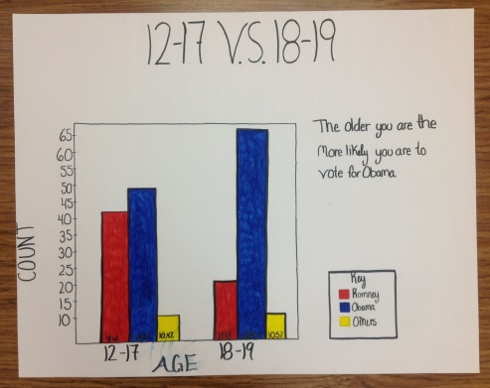
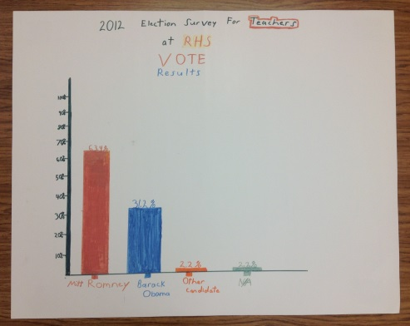
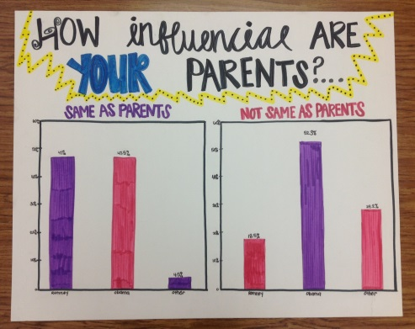
Poster examples

Slide 18
What about part 3 and 4?
Sorry… I’ve only got 5 minutes!
But…here’s a couple notes.
The Inference Phase (Phase 3) took WAY too long.
We did not have enough time to design our experiments (Phase 4).

Slide 19
What worked
Giving students creative control
Allowing students to make mistakes
Focusing on real and relevant data
Studying statistical topics on a need-to-know basis
Experiencing the joys and frustrations of collecting and analyzing real data

Slide 20
Plans for the future
Inference needs to be introduced earlier, but…
Maybe formal inference techniques are not necessary for this class
Bootstrapping and randomization might be an option
New question for me: Do these students need to do statistics like statisticians or like statistically literate members of society?
Is there a difference?

