Slide 1
Inference Round Table
Linda Puckett
J. Frank Dobie High School
Houston, Texas

Slide 2
H – Hypothesis
C – Conditions
C – Calculations
C - Conclusion
P – Parameter
C – Conditions
C – Calculations
I - Interpretation
Acronyms work, IF they remember them!
Kagan
Cooperative Learning

Slide 3
Round Table Activity
Groups of 3 or 4 students
Worksheet set up
Procedure
ALL work first block
Pass papers
Grade block (discussion, if needed) & initial
ALL work next block
REPEAT until all blocks complete and correct

Slide 4
Inference Problem
Hypotheses | Conditions
Calculations | Conclusion

Slide 5
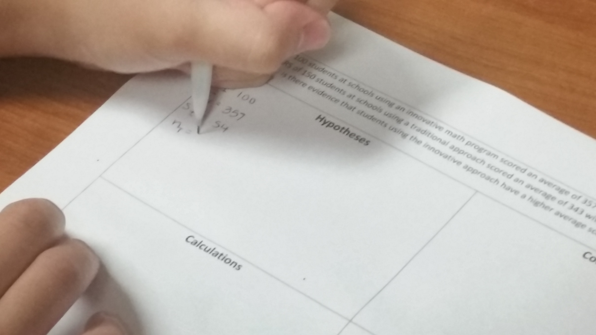
Stating the hypotheses and the given information

Slide 6
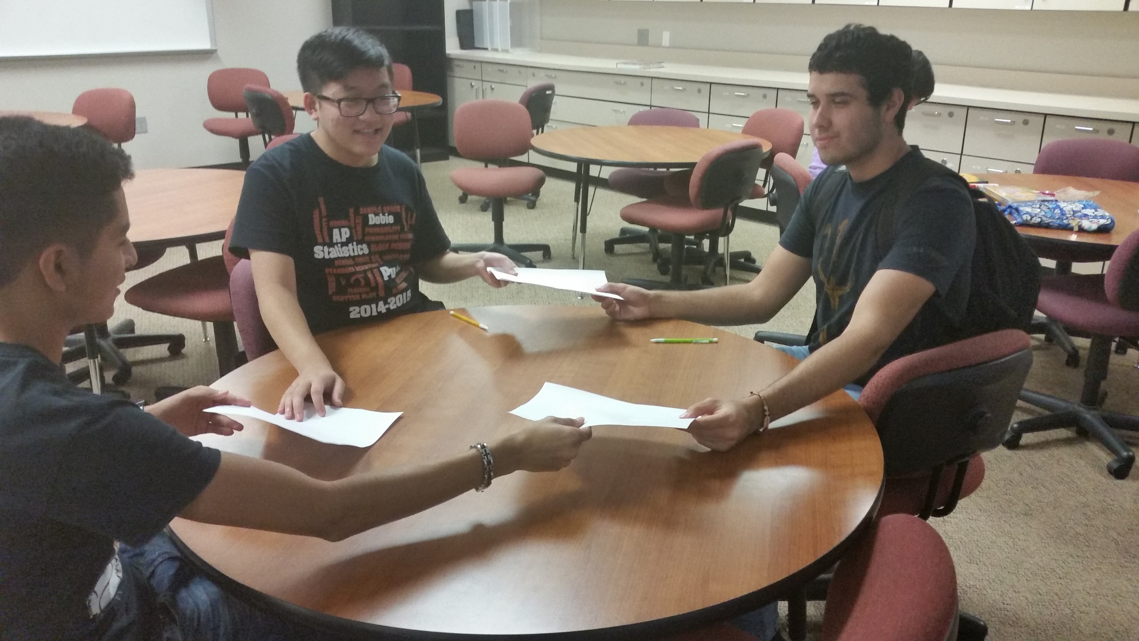
Passing the papers

Slide 7
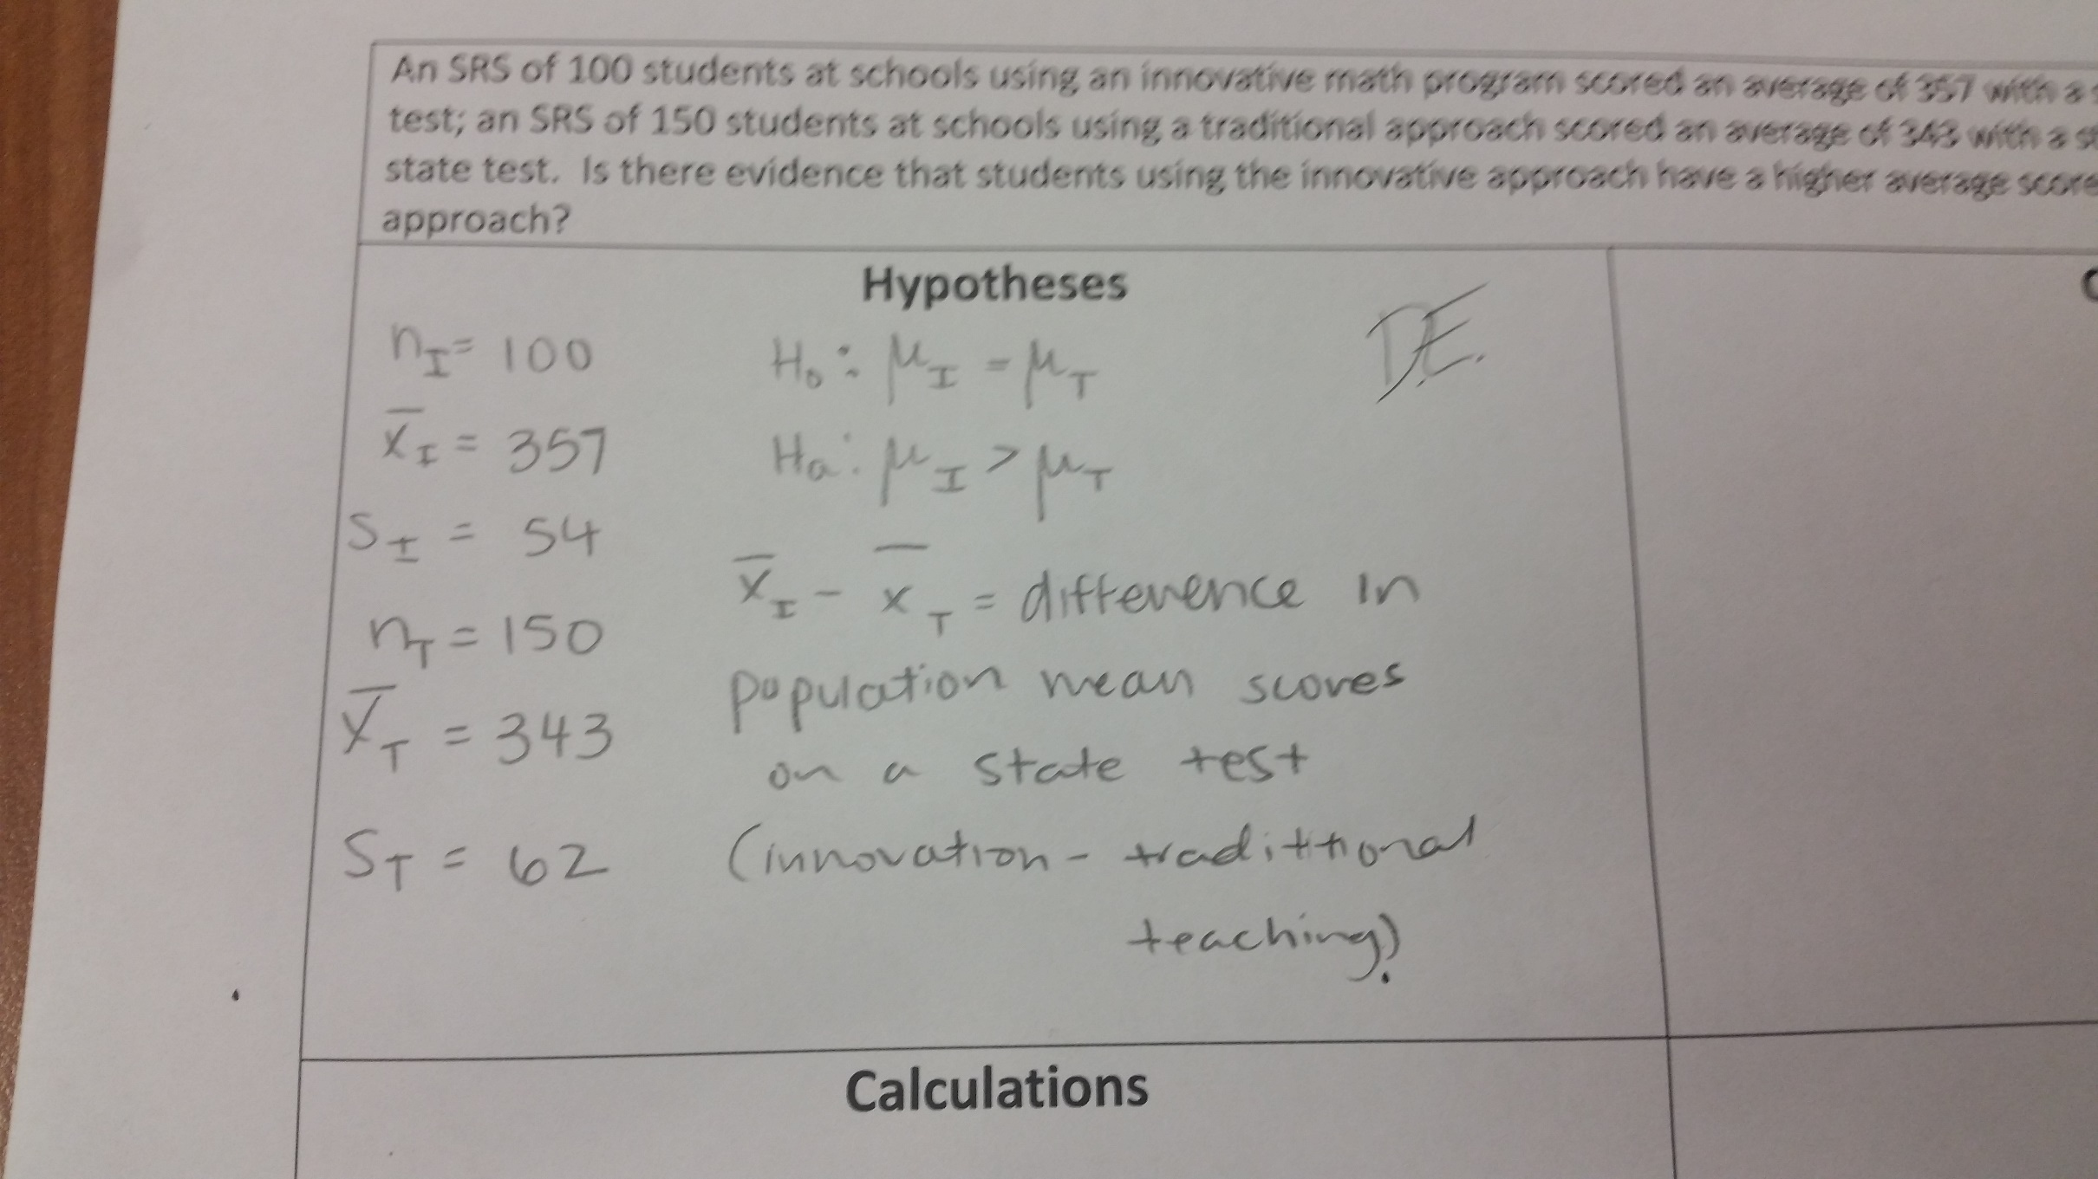
Grading and initialing the completed box.

Slide 8
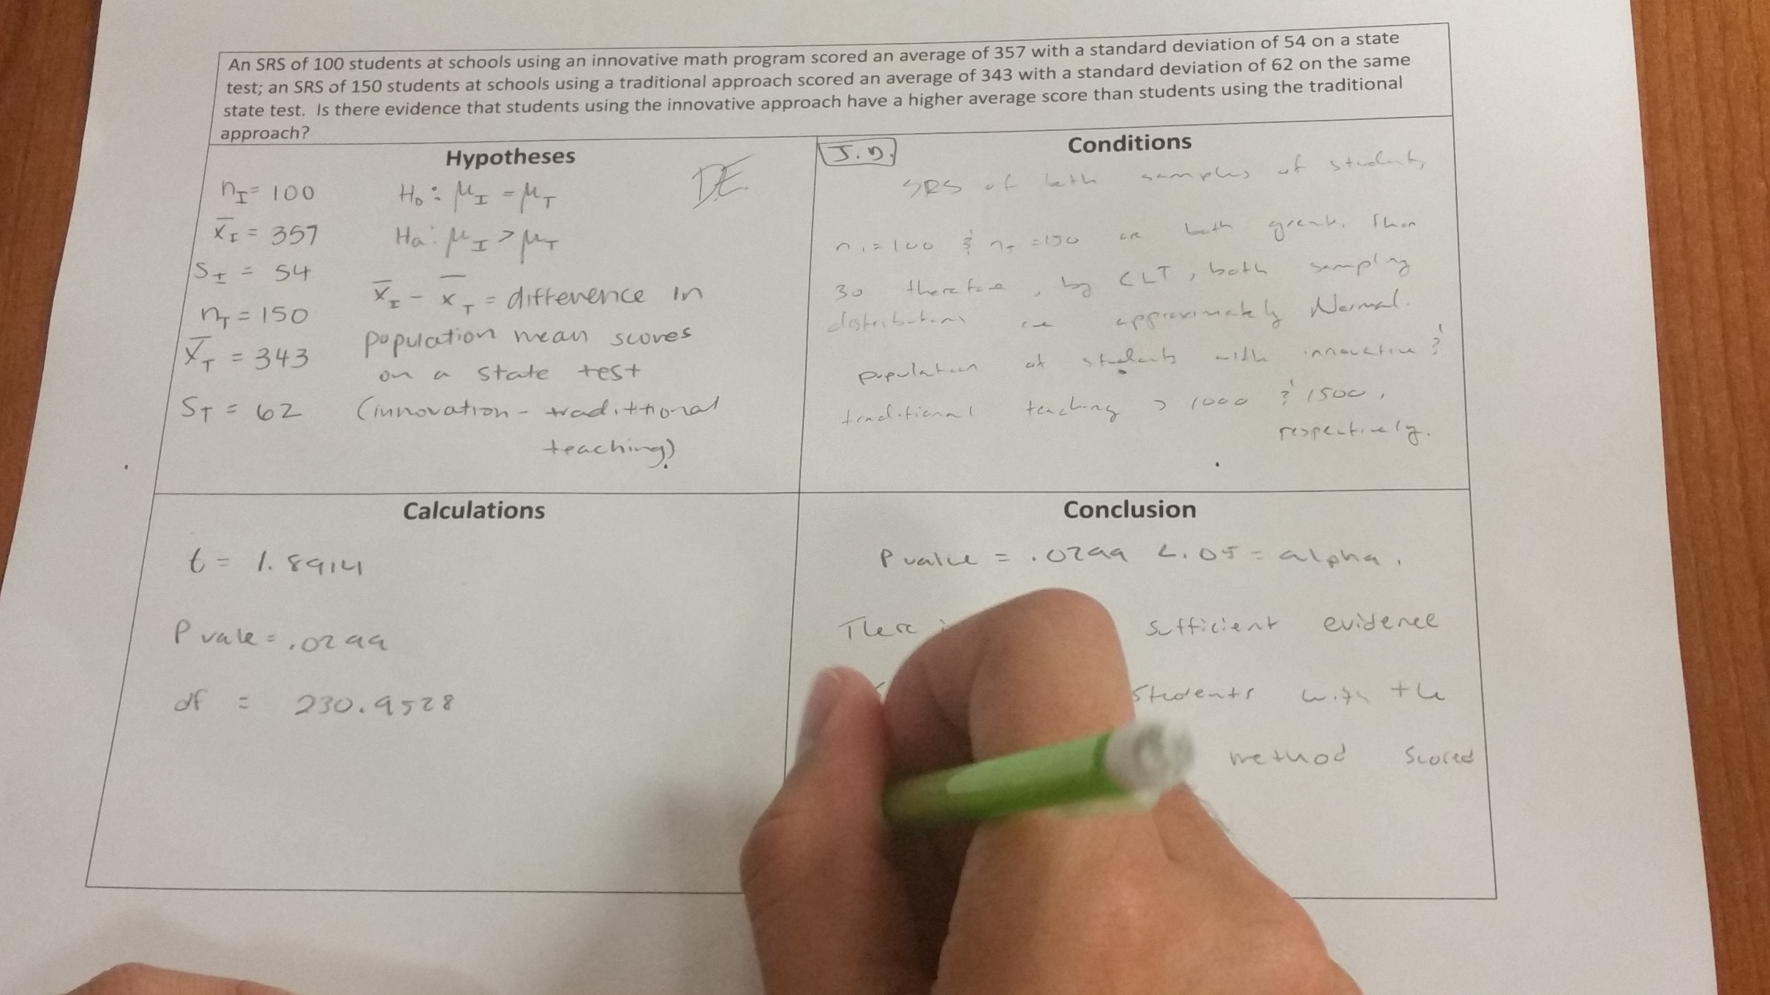

Slide 9
Students repeat the process for the “Conditions” using the paper they GRADED.
Pass again.
Grade again.
Repeat until ALL boxes are complete.
Return paper to original owner.

Slide 10
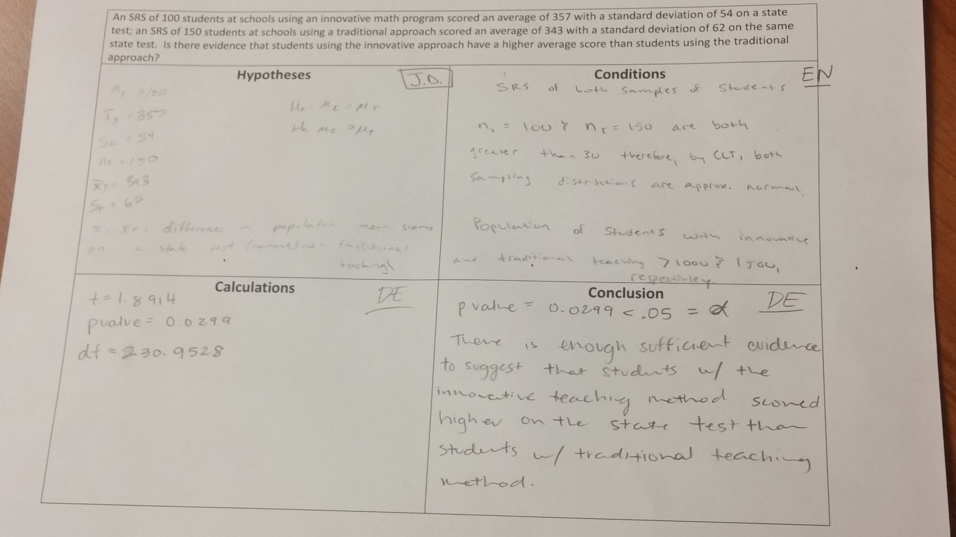
Completed Hypothesis Test.

Slide 11
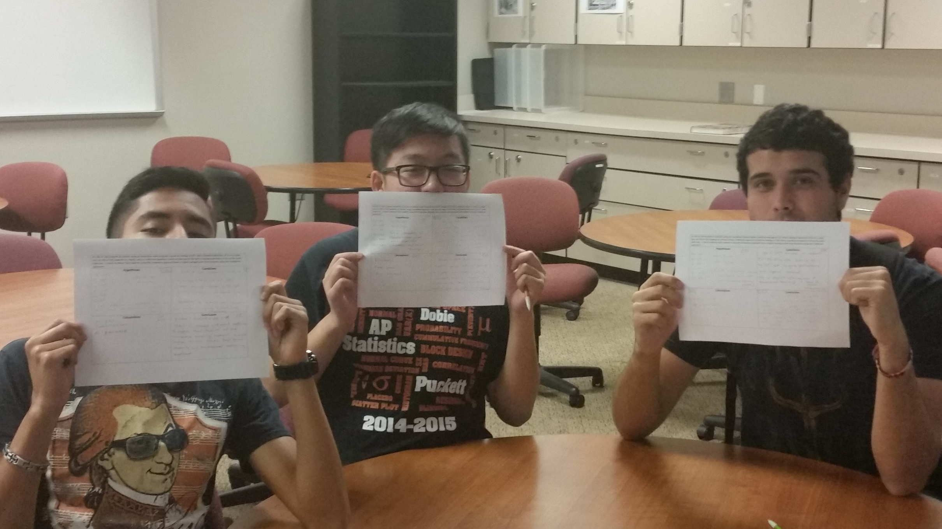
Student has a completed & CORRECT Hypothesis Test

Slide 12
Work one together as a class
Students work one as a table
Assign homework for student to work independently
Visual
Aural
Read/Write
Kinesthetic

Slide 13
Issues that come up “What box does ___ go in?” (it doesn’t matter) “Do I HAVE to use the boxes?” (No) “What if I put the information in the ‘wrong’ box?” (it doesn’t matter)

