Slide 1
Morbid Math: A t-distribution Exercise
Brianna Kurtz
Associate Professor of Mathematics and Statistics
Daytona State College
Daytona Beach, FL

Slide 2
General Purpose
Have students analyze data and be able to locate appropriate values (without being handed a clean data set)
Understand the construction of confidence intervals
Be able to analyze confidence interval results and how they compare to a given value

Slide 3
The activity
Morbid Math – A T-distribution Exercise
Today you will be doing your own data collection to determine how the life expectancy of people in the Daytona Beach area compares to the mean life expectancy of people in the United States (μ = 79.56, according to the CIA World Factbook 2014 estimate). Please go through today’s obituary section and collect your sample of the ages at death for each individual listed. Once you have your data, construct a 95% confidence interval.

Slide 4
The activity
Confidence Interval: ( , )
How does this compare to our population mean?

Slide 5
The activity
Part II: Now let’s look by gender. According to the same study, the average life expectancy for women in the United States is 81.94. For men, it is 77.11. Using your same data, calculate a 99% confidence interval for men and a 99% confidence interval for women. How does this compare?

Slide 6
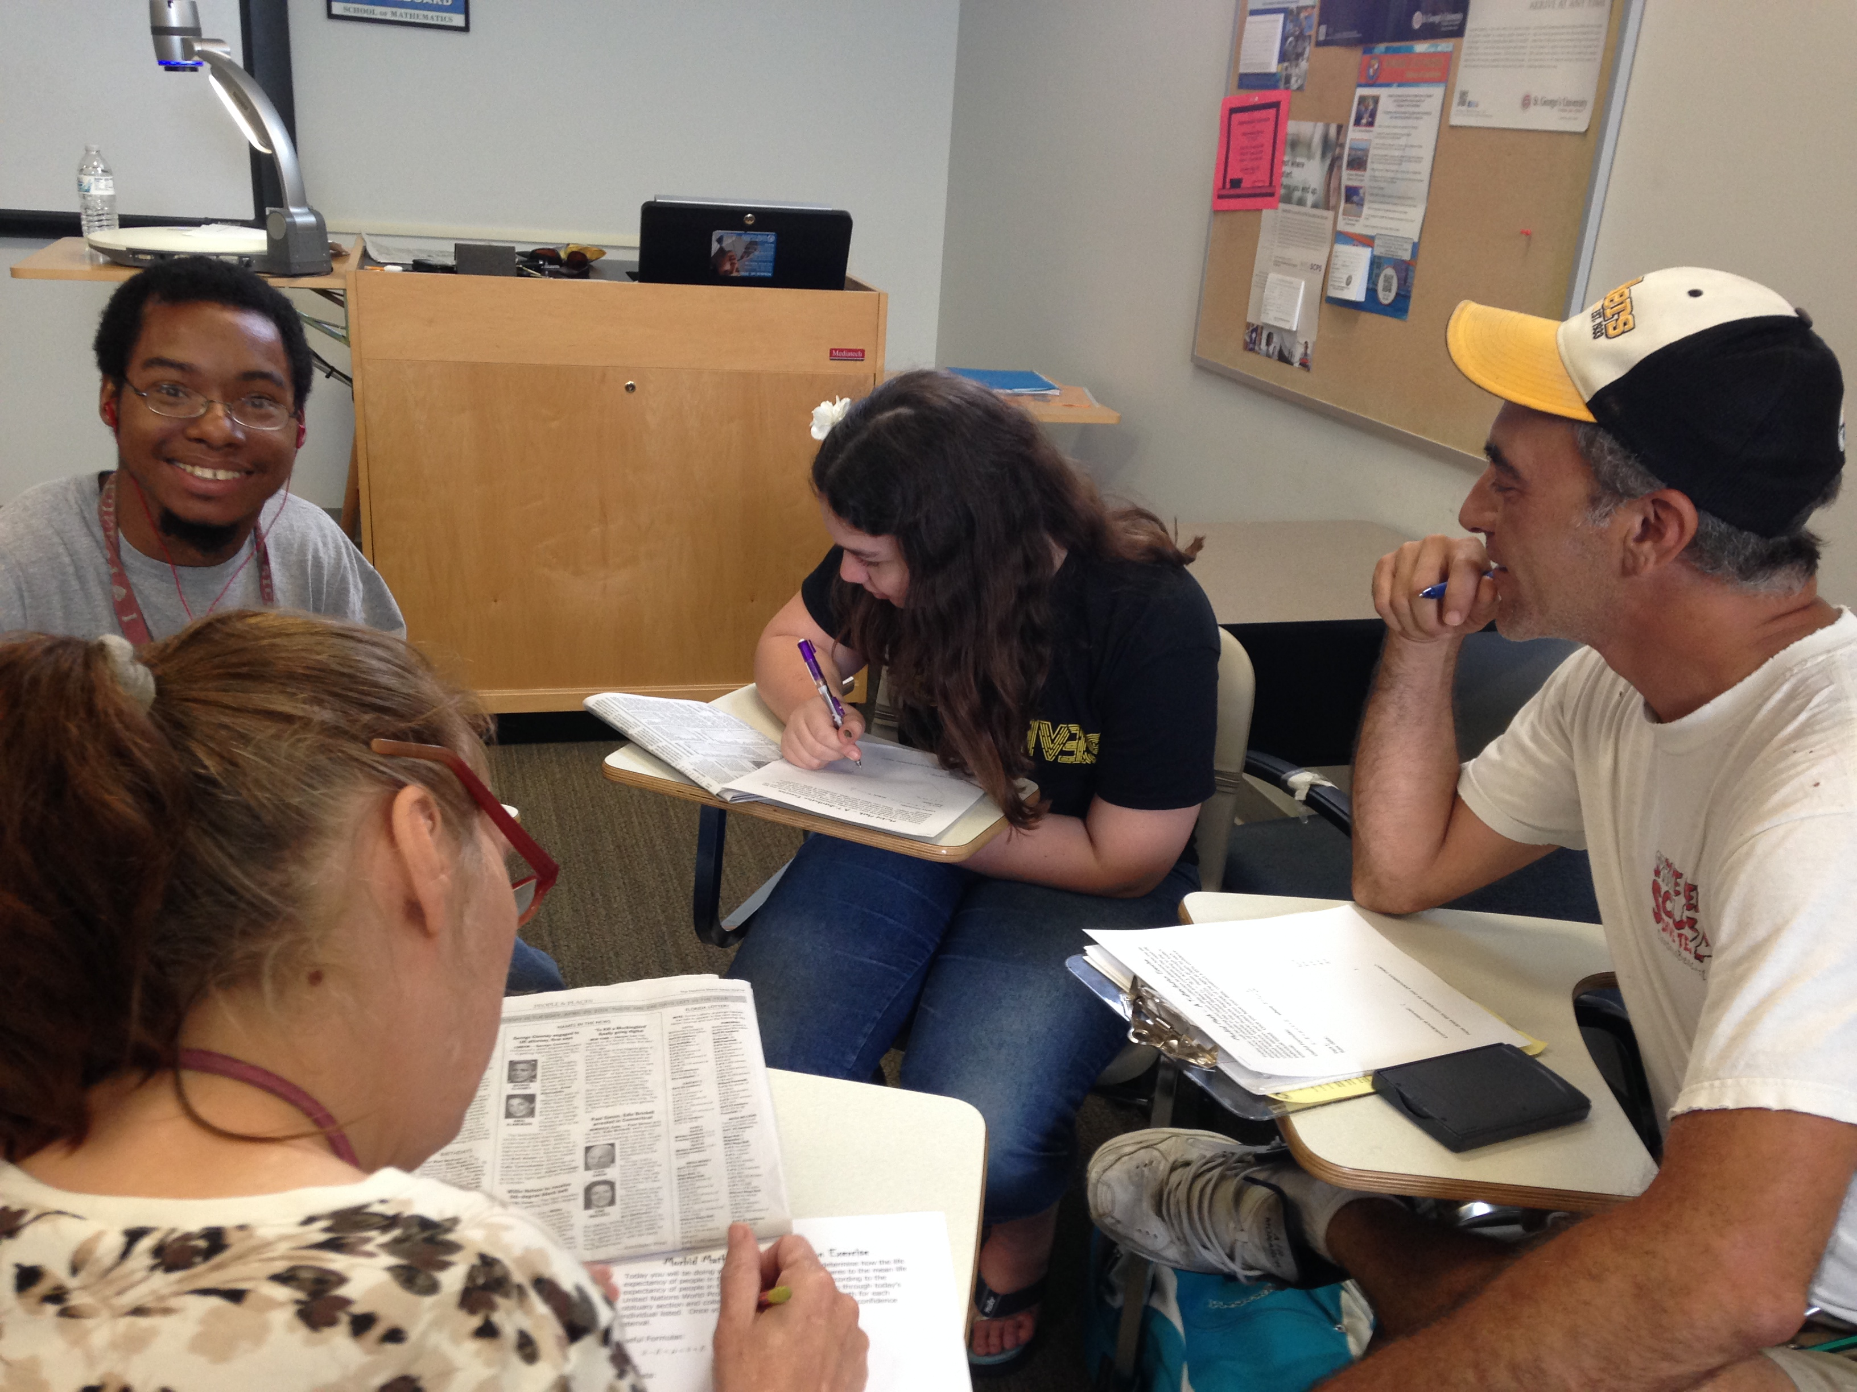
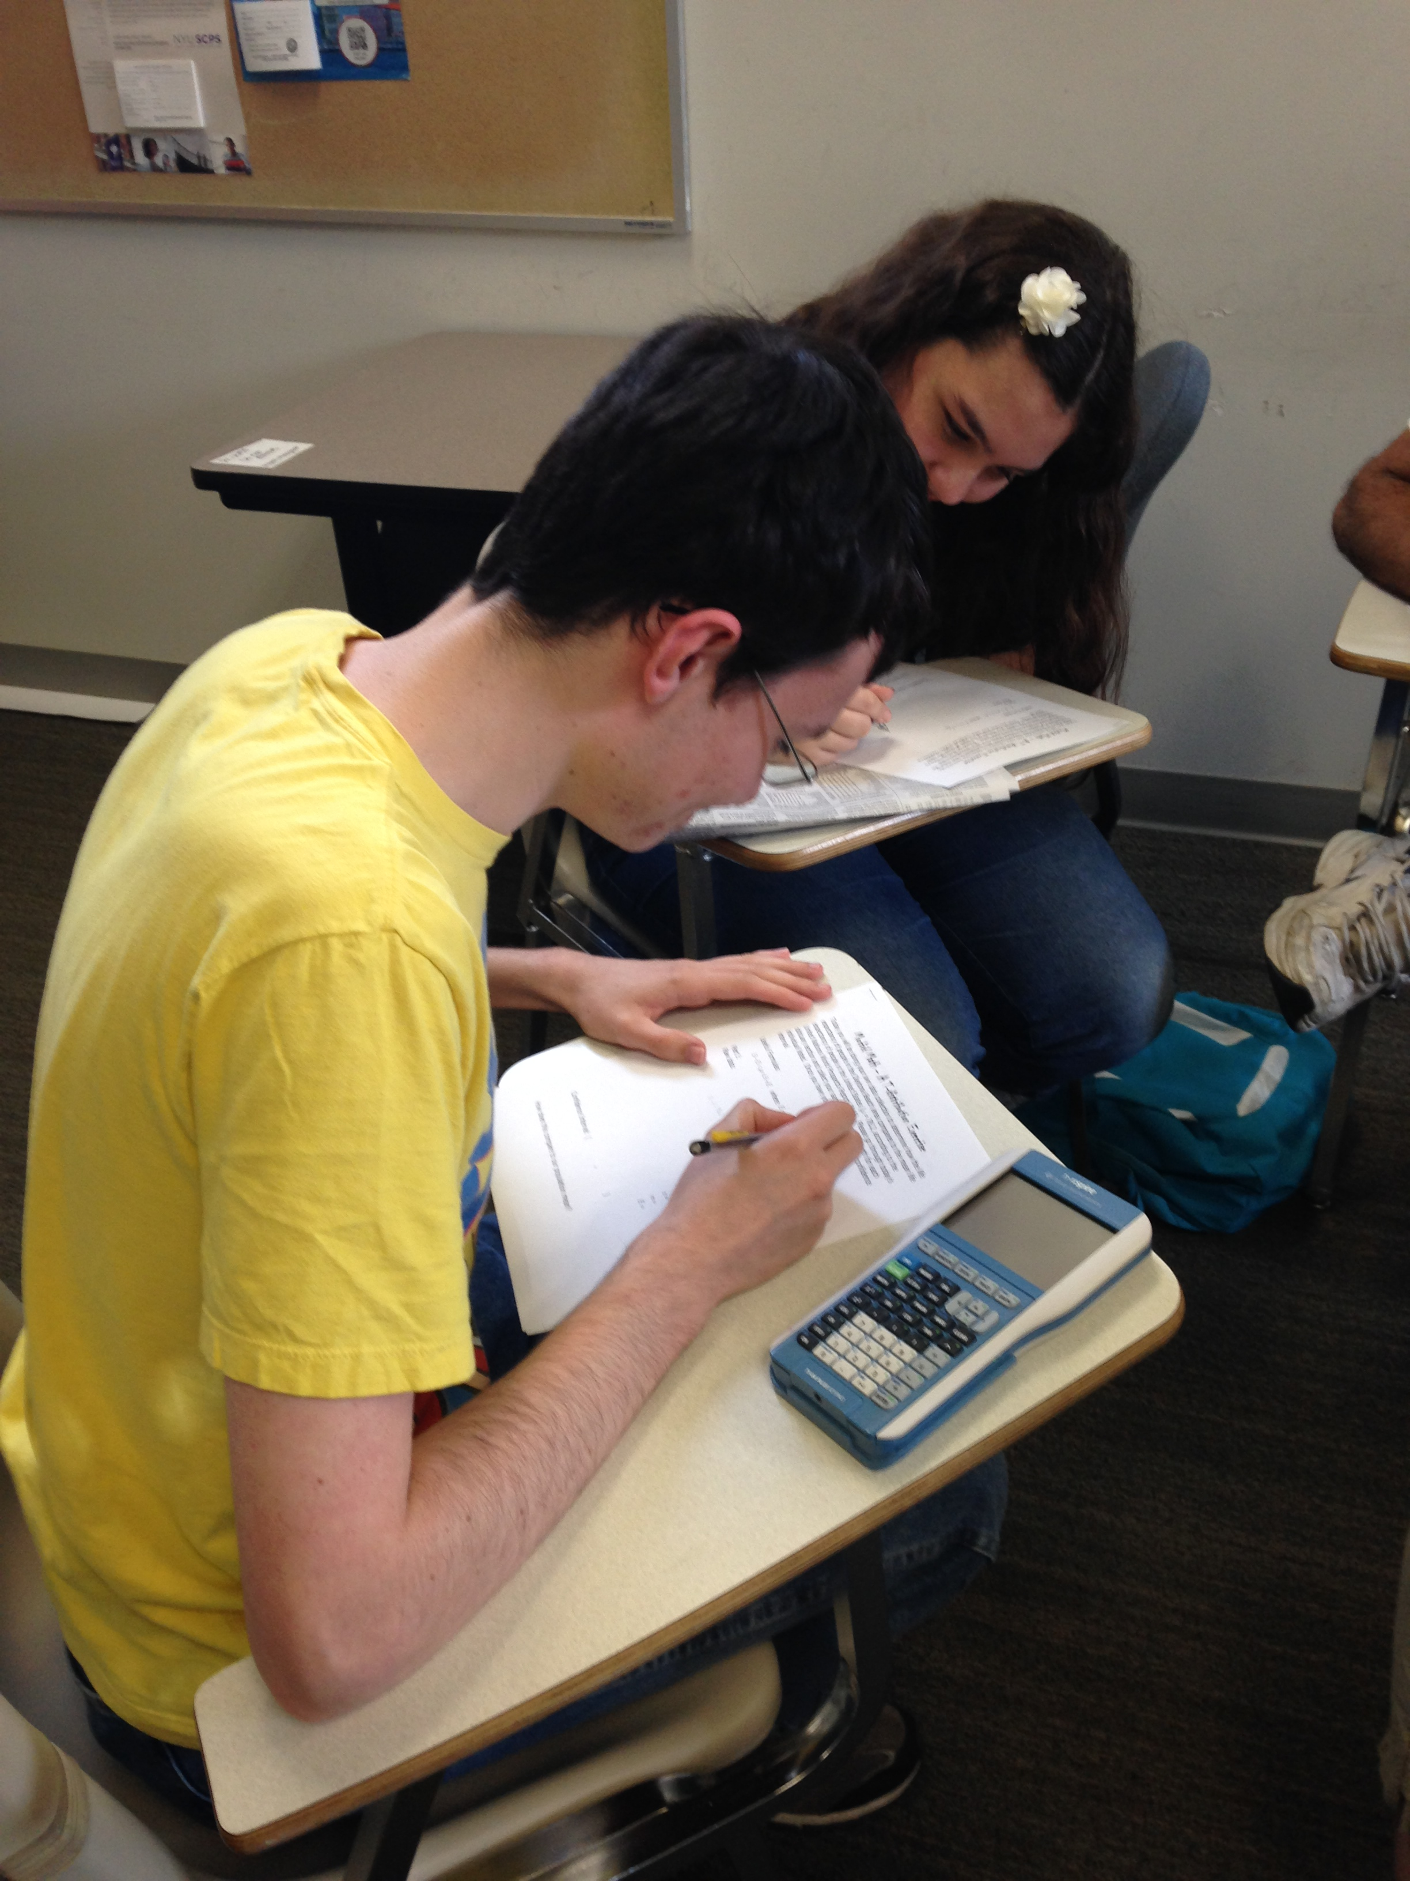
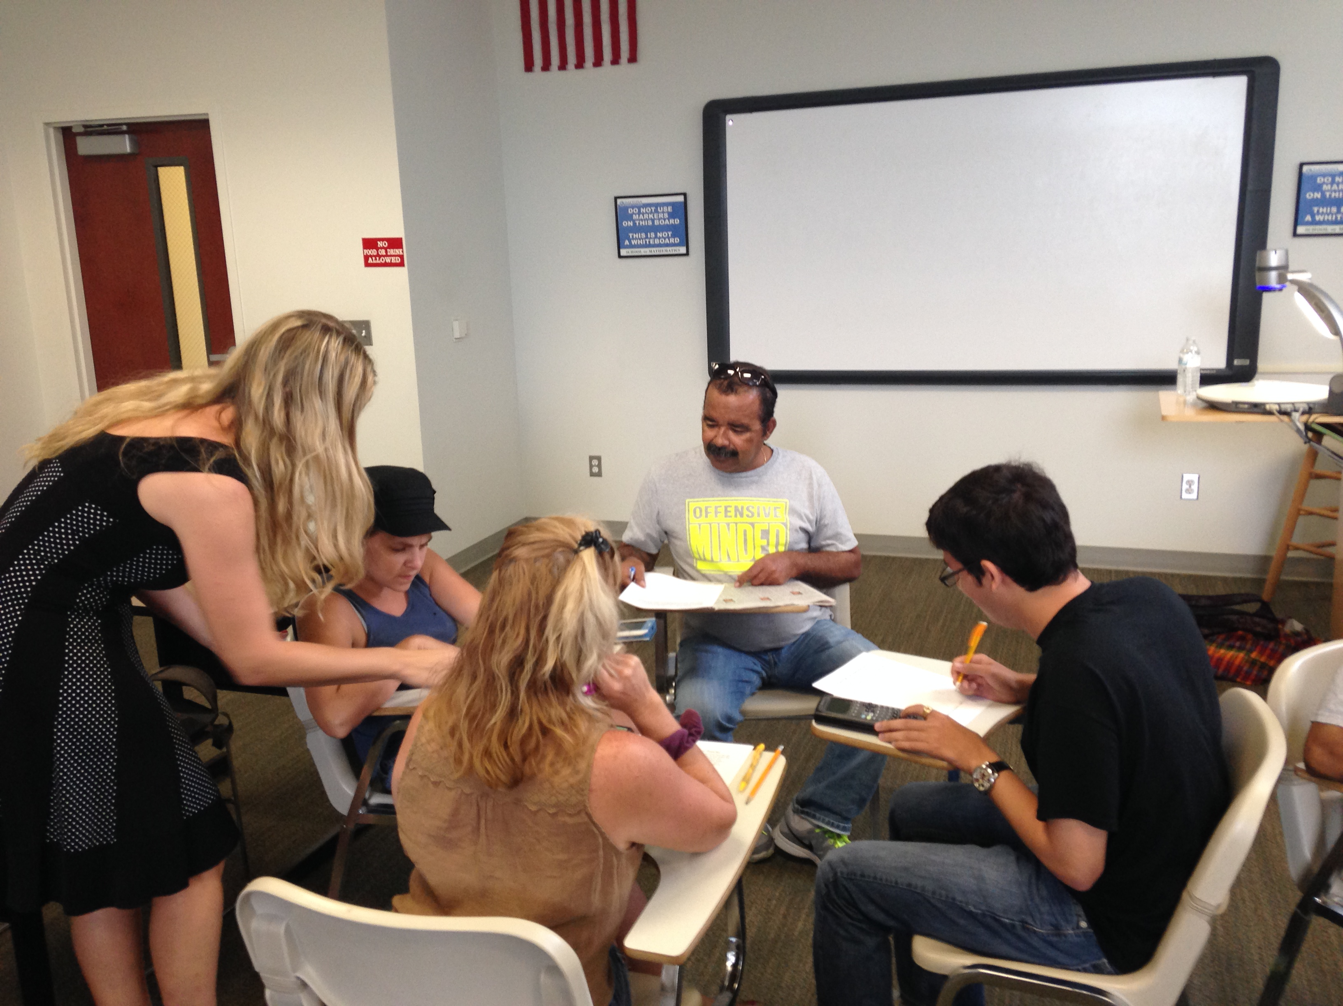
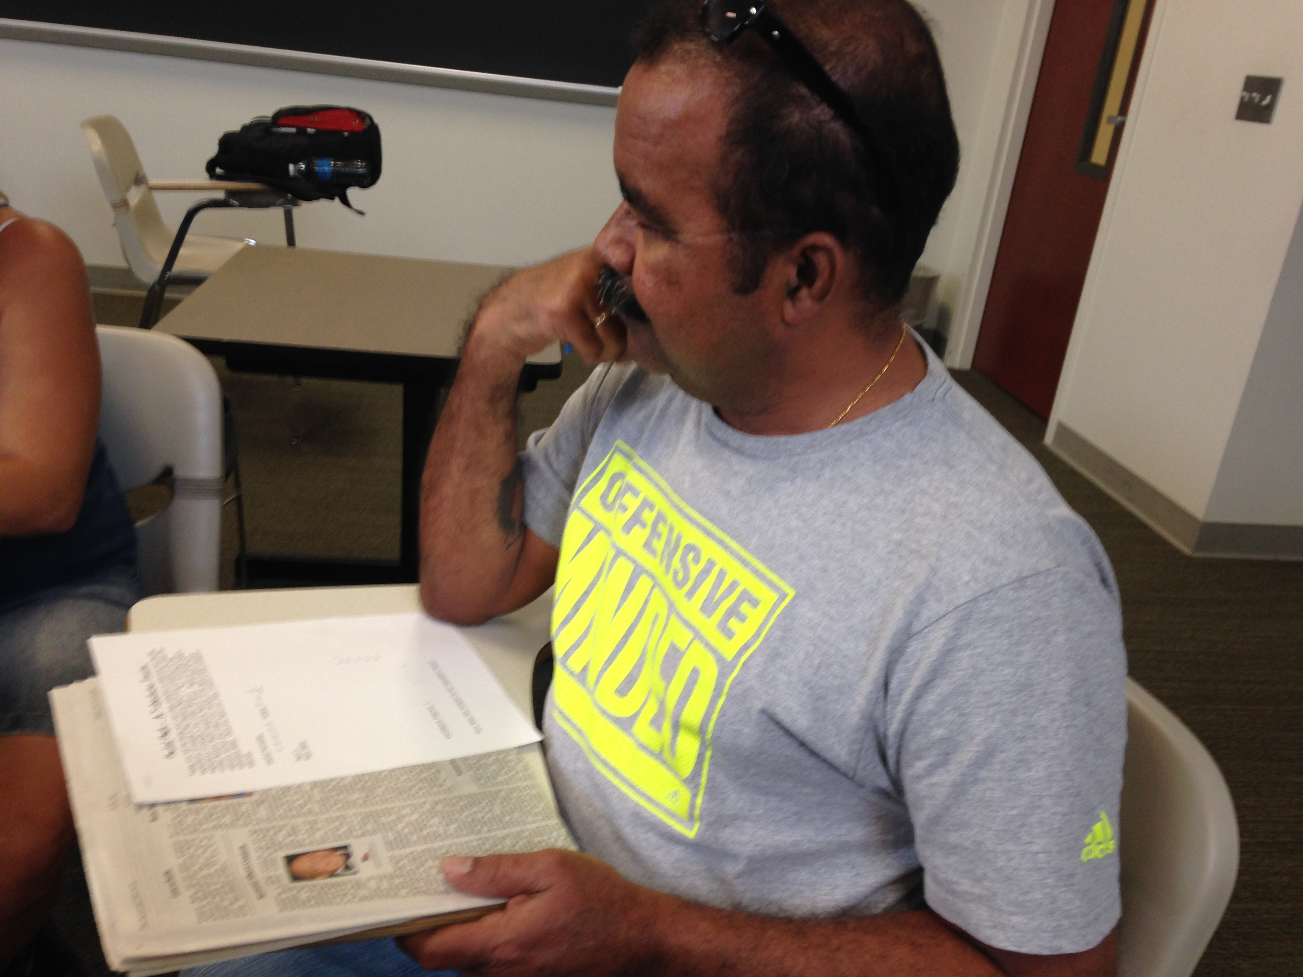

Slide 7
Mishaps and Pitfalls
Ease of counting a single data point twice
In Memoriam vs. Obituary
Lack of age of death being provided
Knowledge of the deceased

Slide 8
Variations on the Activity
Newspapers from the same date but from different locations
Daytona Beach newspaper from different times during the year

Slide 9
kurtzb@daytonastate.edu

